Slide 1
DSC3013 Intro. to Social
Media Analytics (Lec. 5)
Hao PENG
Department of Data Science
City University of Hong Kong
https://haoopeng.github.io/

Slide 2
Sentiment Analysis
Dictionary based approach
Word Lexicon (sum up positivity score for each word)
With pre-defined Rules (e.g., handle negation)
  https://github.com/cjhutto/vadersentiment
  https://github.com/trinker/sentimentr
Machine learning based approach
Training data is needed
  texts (X) with human-annotated sentiment labels (y)
Model evaluation
  AUC-ROC
  F1-score

Slide 3
Beyond sentiment prediction
Emotion classification
Spam/clickbait detection
Helpfulness rating on Q&A sites
Complain/fake product reviews
Civility/toxicity/hateful speech
Language identification of posts
Identify AIGC posts on Instagram
Fake news / bot account detection
Need advanced methods to deal with complex linguistic tasks.

Slide 4
Feature engineering
Word-level (covered in DSC2005):
  Bag of words, N-grams
  TF-IDF
Dictionary-level:
  LIWC (closed lexicon)
  LDA (open vocabulary)
Embeddings:
  Word2vec
  Neural nets (CNN/RNN/LSTM)
  Transformer (LLMs)

Slide 5
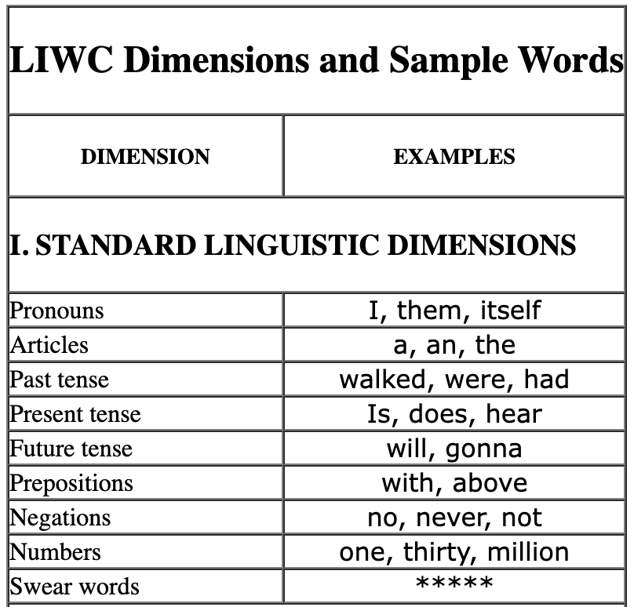
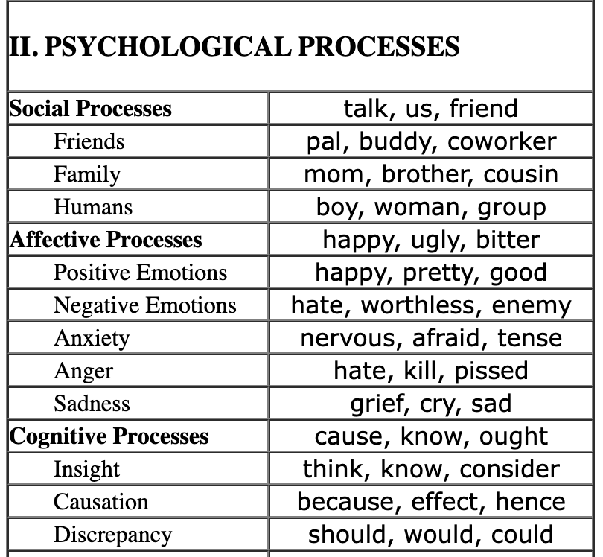
LIWC Dictionary (bag of topics)
Linguistic Inquiry and Word Count (LIWC)
Closed-vocabulary: fixed word dictionary look up
Feature engineering: aggregate word count into category count
https://lit.eecs.umich.edu/geoliwc/liwc_dictionary.html

Slide 6
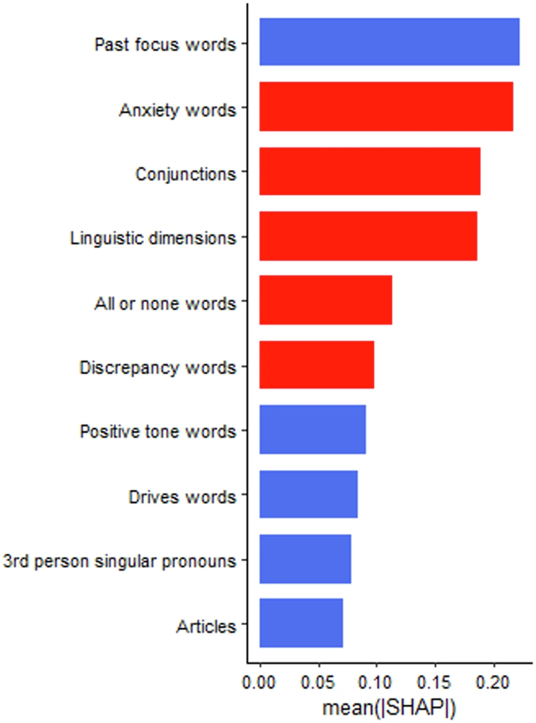
Linguistic marker of Anxiety
Categories ranked by feature importance.
Blue (red) denotes negative (positive) correlation coeff.
Advantages of LIWC?
Any disadvantages?
https://www.nature.com/articles/s44184-025-00140-y
Notes:
The blue shading indicates the linguistic features with negative associations with anxiety symptoms whereas the red shading indicates linguistic with positive associations with anxiety symptoms.

Slide 7
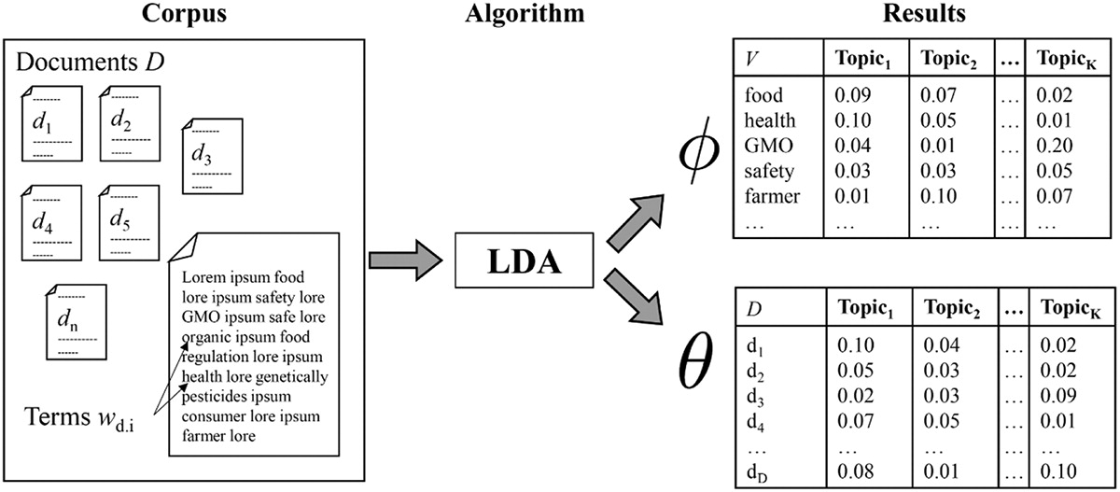
LDA topic modeling
Latent Dirichlet Allocation (LDA) is a generative statistical model for automatically discovering hidden topics across a set of documents (Unsupervised learning; Open-vocabulary approach)
Represent documents as prob. distribution of topics
Represent the topics are prob. distributions of words
https://doi.org/10.1080/19312458.2018.1430754

Slide 8
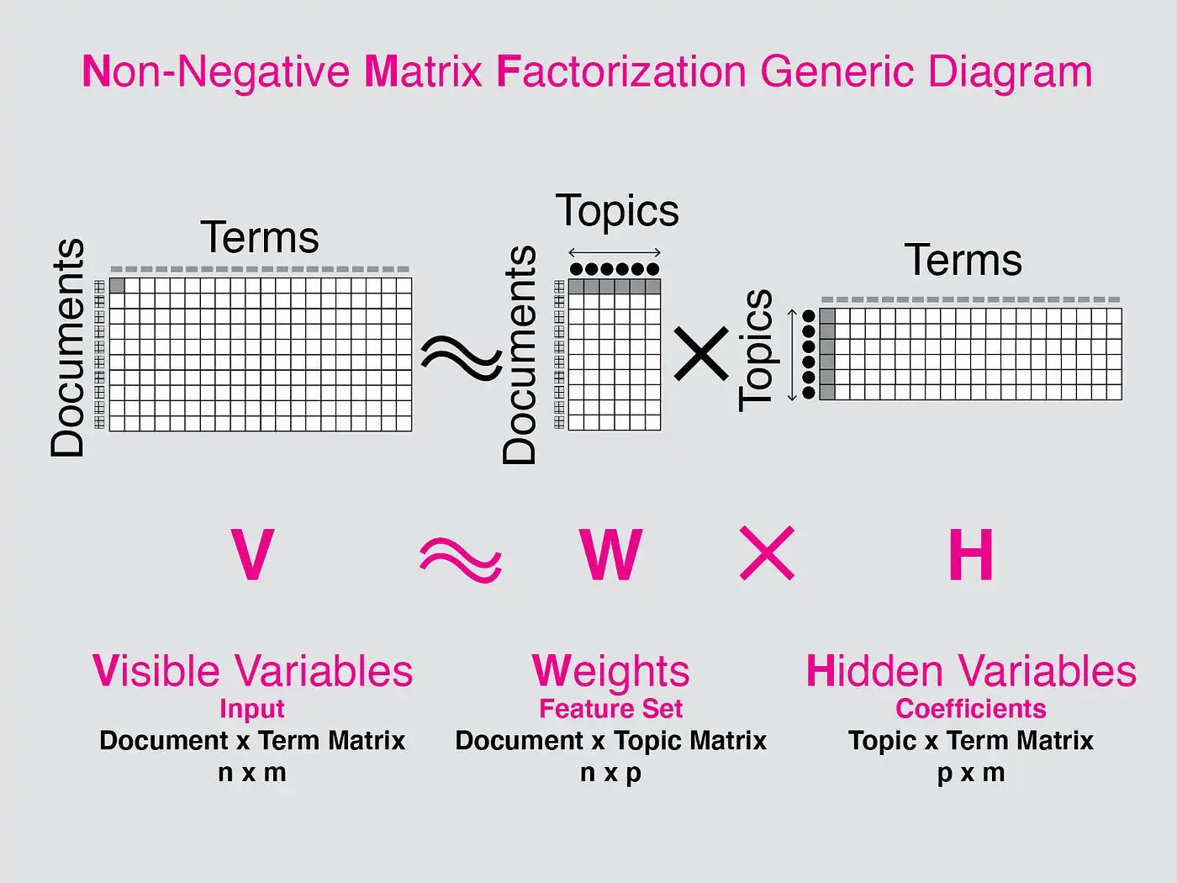
LDA topic modeling
LDA is similar with PCA. They both are matrix factorization techniques.
LDA is applied to text data. It works by decomposing the Document Word Matrix (the larger matrix) into two parts (smaller matrices): the Document Topic Matrix and the Topic Word Matrix.
Notes:
Topics matrix is the PC scores
Terms matrix is the PC loadings

Slide 9
Applications of LDA
LDA can transform data into low dimensional feature space
Perform predictive tasks using the document-topic matrix:
  categorize news (sports, politics, tech, etc.)
  book / music / movie genre classification
  recommendation system; document search
  predict user age, gender, ethnicity, sentiment, etc.

Slide 10
Limitations of LDA
Doesn’t work well on short document (such as Tweets).
LDA relies on the assumption that words in each topic are related and meaningful, but this may not always be the case.
It can produce ambiguous or incoherent topics.
Not straightforward to evaluate topics’ quality.

Slide 11
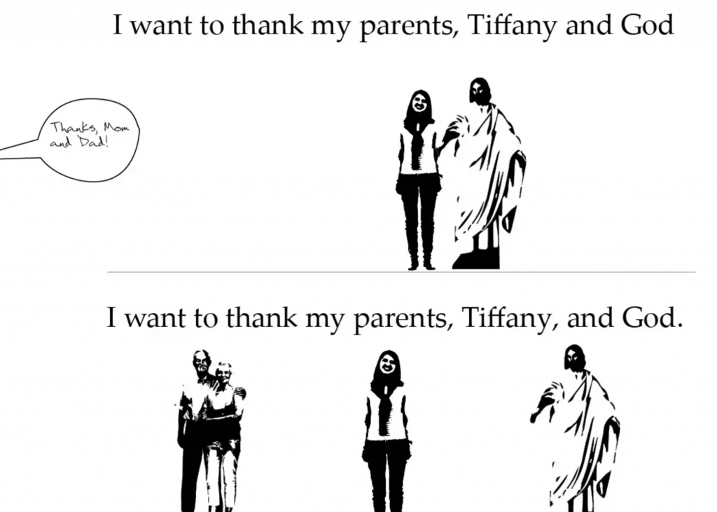
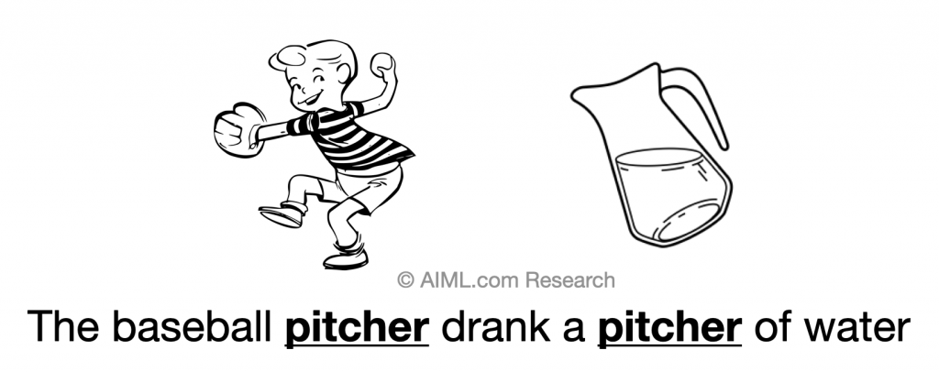
Recall weaknesses of BoW
High dimension, Sparsity
Ignores order and context
Lack of semantic nuance
https://aiml.com/what-are-the-advantages-and-disadvantages-of-bag-of-words-model/
Notes:
Insensitivity to grammatical structure, Limited semantic information

Slide 12
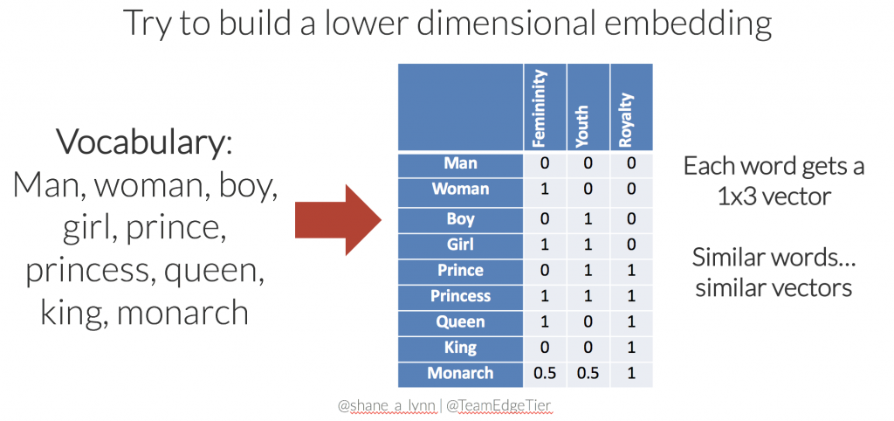
Vector-space model
Captures deeper semantic and linguistic nuances
https://www.shanelynn.ie/get-busy-with-word-embeddings-introduction/

Slide 13
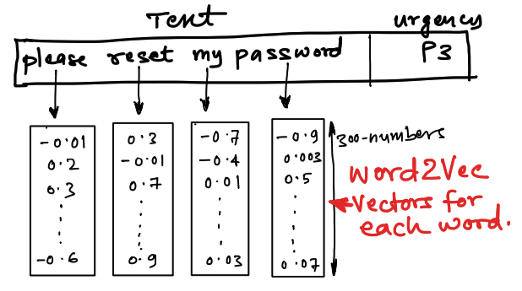
Word2vec idea
Learns dense vector representation of each word
  often 50-500D (vs. 10k in BOW); unsupervised
https://thinkingneuron.com/how-to-classify-text-using-word2vec/

Slide 14
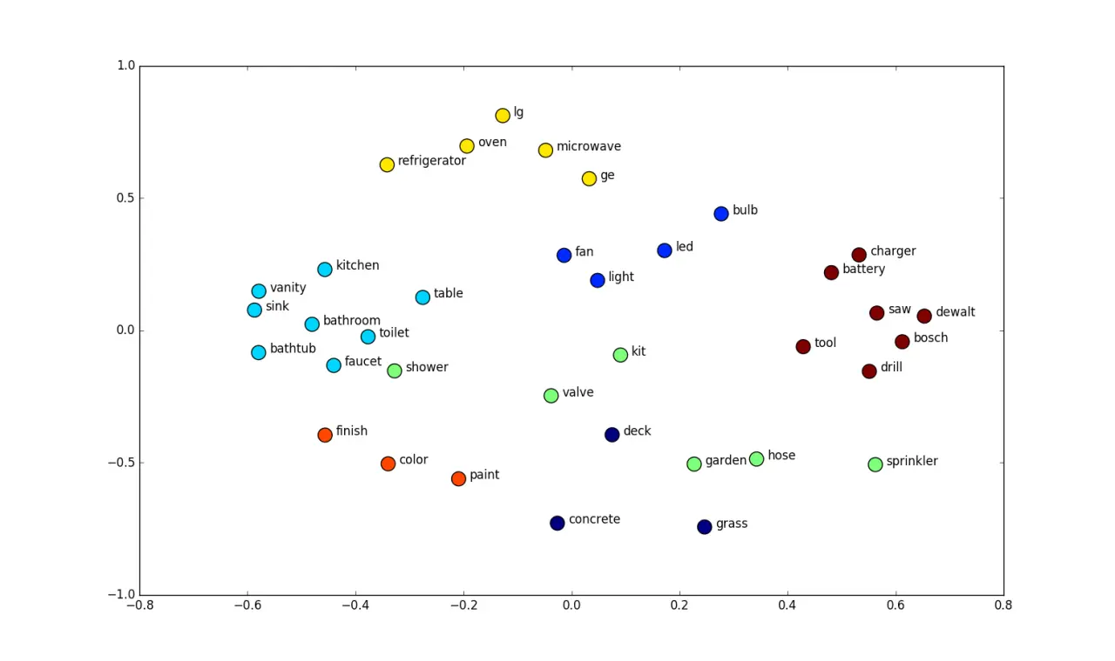
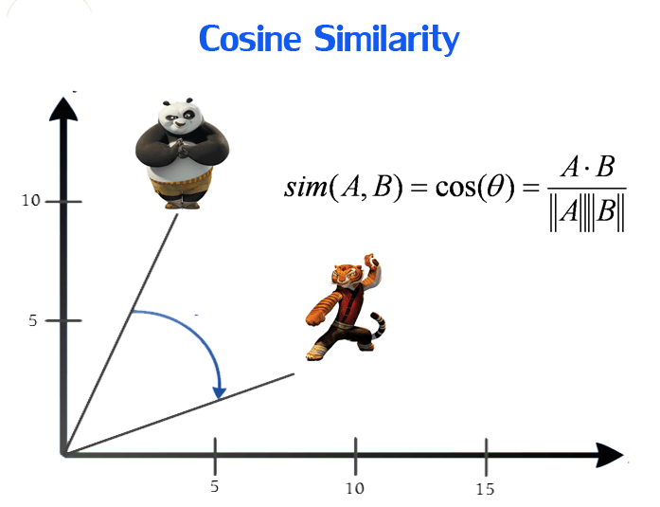
Word2vec idea
Learns dense vector representation of each word
  often 50-500D (vs. 10k in BOW); unsupervised
Words appear in similar context have similar vectors
https://www.kaggle.com/code/samuelcortinhas/nlp7-word-embeddings

Slide 15
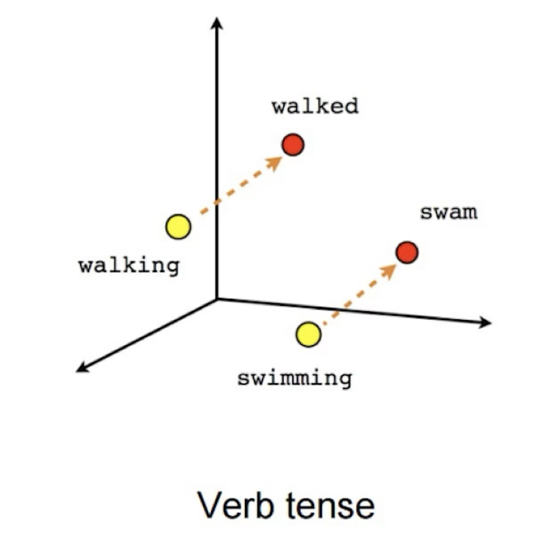
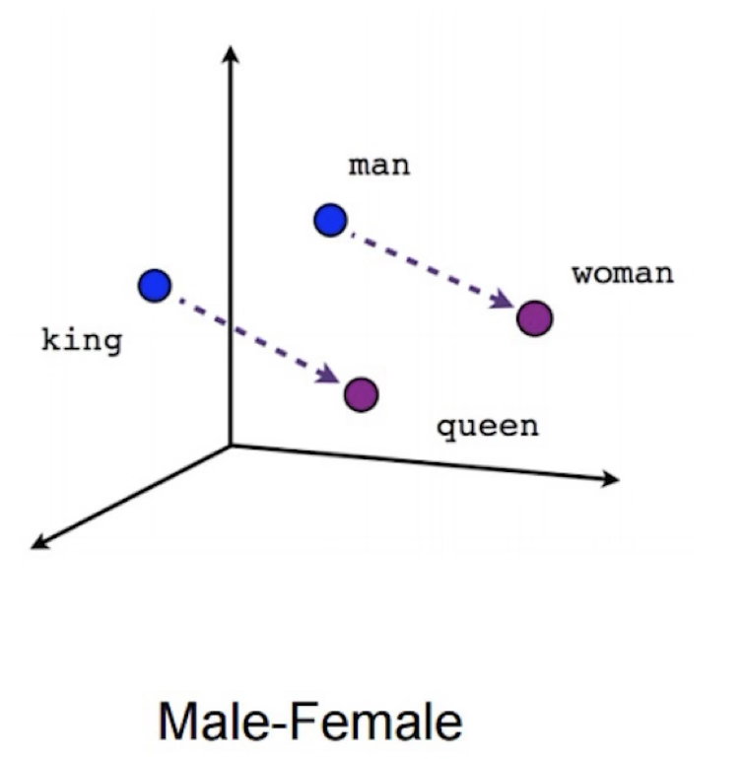
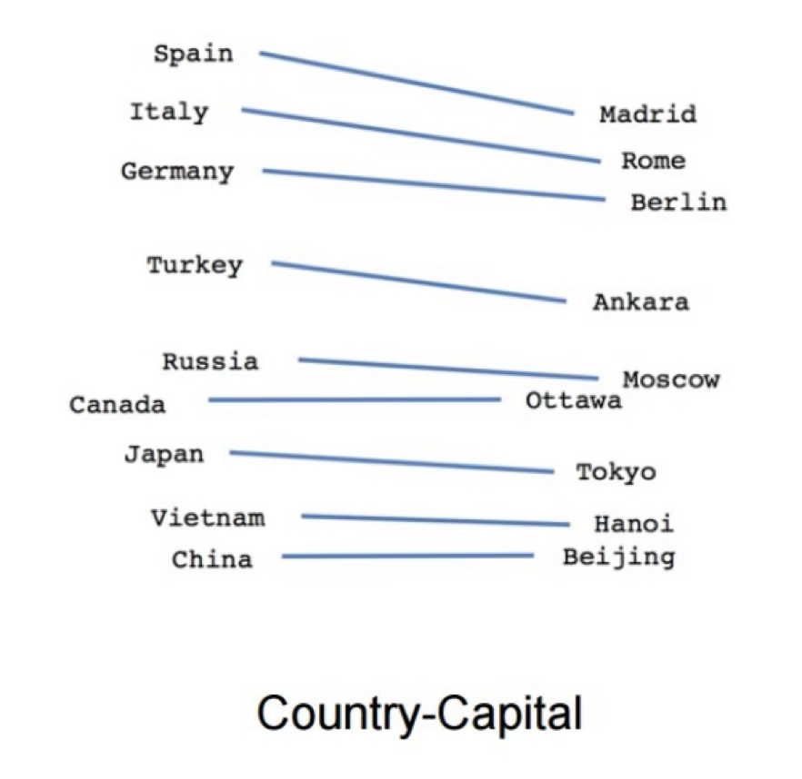
Word2vec idea
Learns dense vector representation of each word
  often 50-500D (vs. 10k in BOW); unsupervised
Words appear in similar context have similar vectors
Latent dimensions capture syntactic/semantic meaning
https://www.shanelynn.ie/get-busy-with-word-embeddings-introduction/

Slide 16
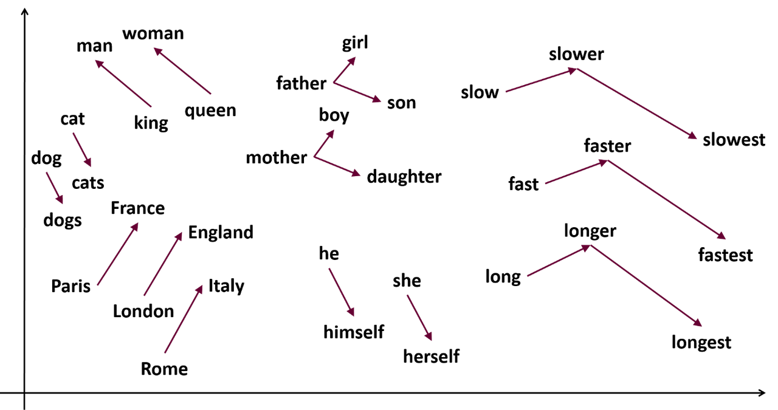
Word2vec magic
Word analogy using vector operations
E.g., “king” - “man” + “woman” = "queen"
https://www.kaggle.com/code/samuelcortinhas/nlp7-word-embeddings
Notes:
This means that these vectors can capture very precisely abstract concepts (like gender and royalty) without any input from us.

Slide 17
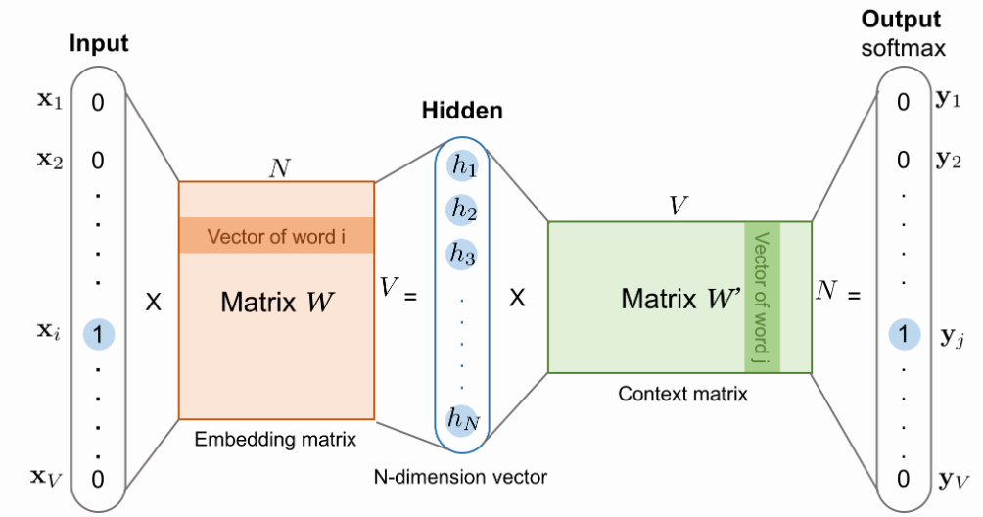
Word2vec training setup
V is the vocabulary size; N is the num of embedding dimensions
Input is one-hot encoding of each word (1 x V)
W is (V x N), W’ is (N x V)
Notes:
Set the max y_{j} as 1 in the output prob.

Slide 18
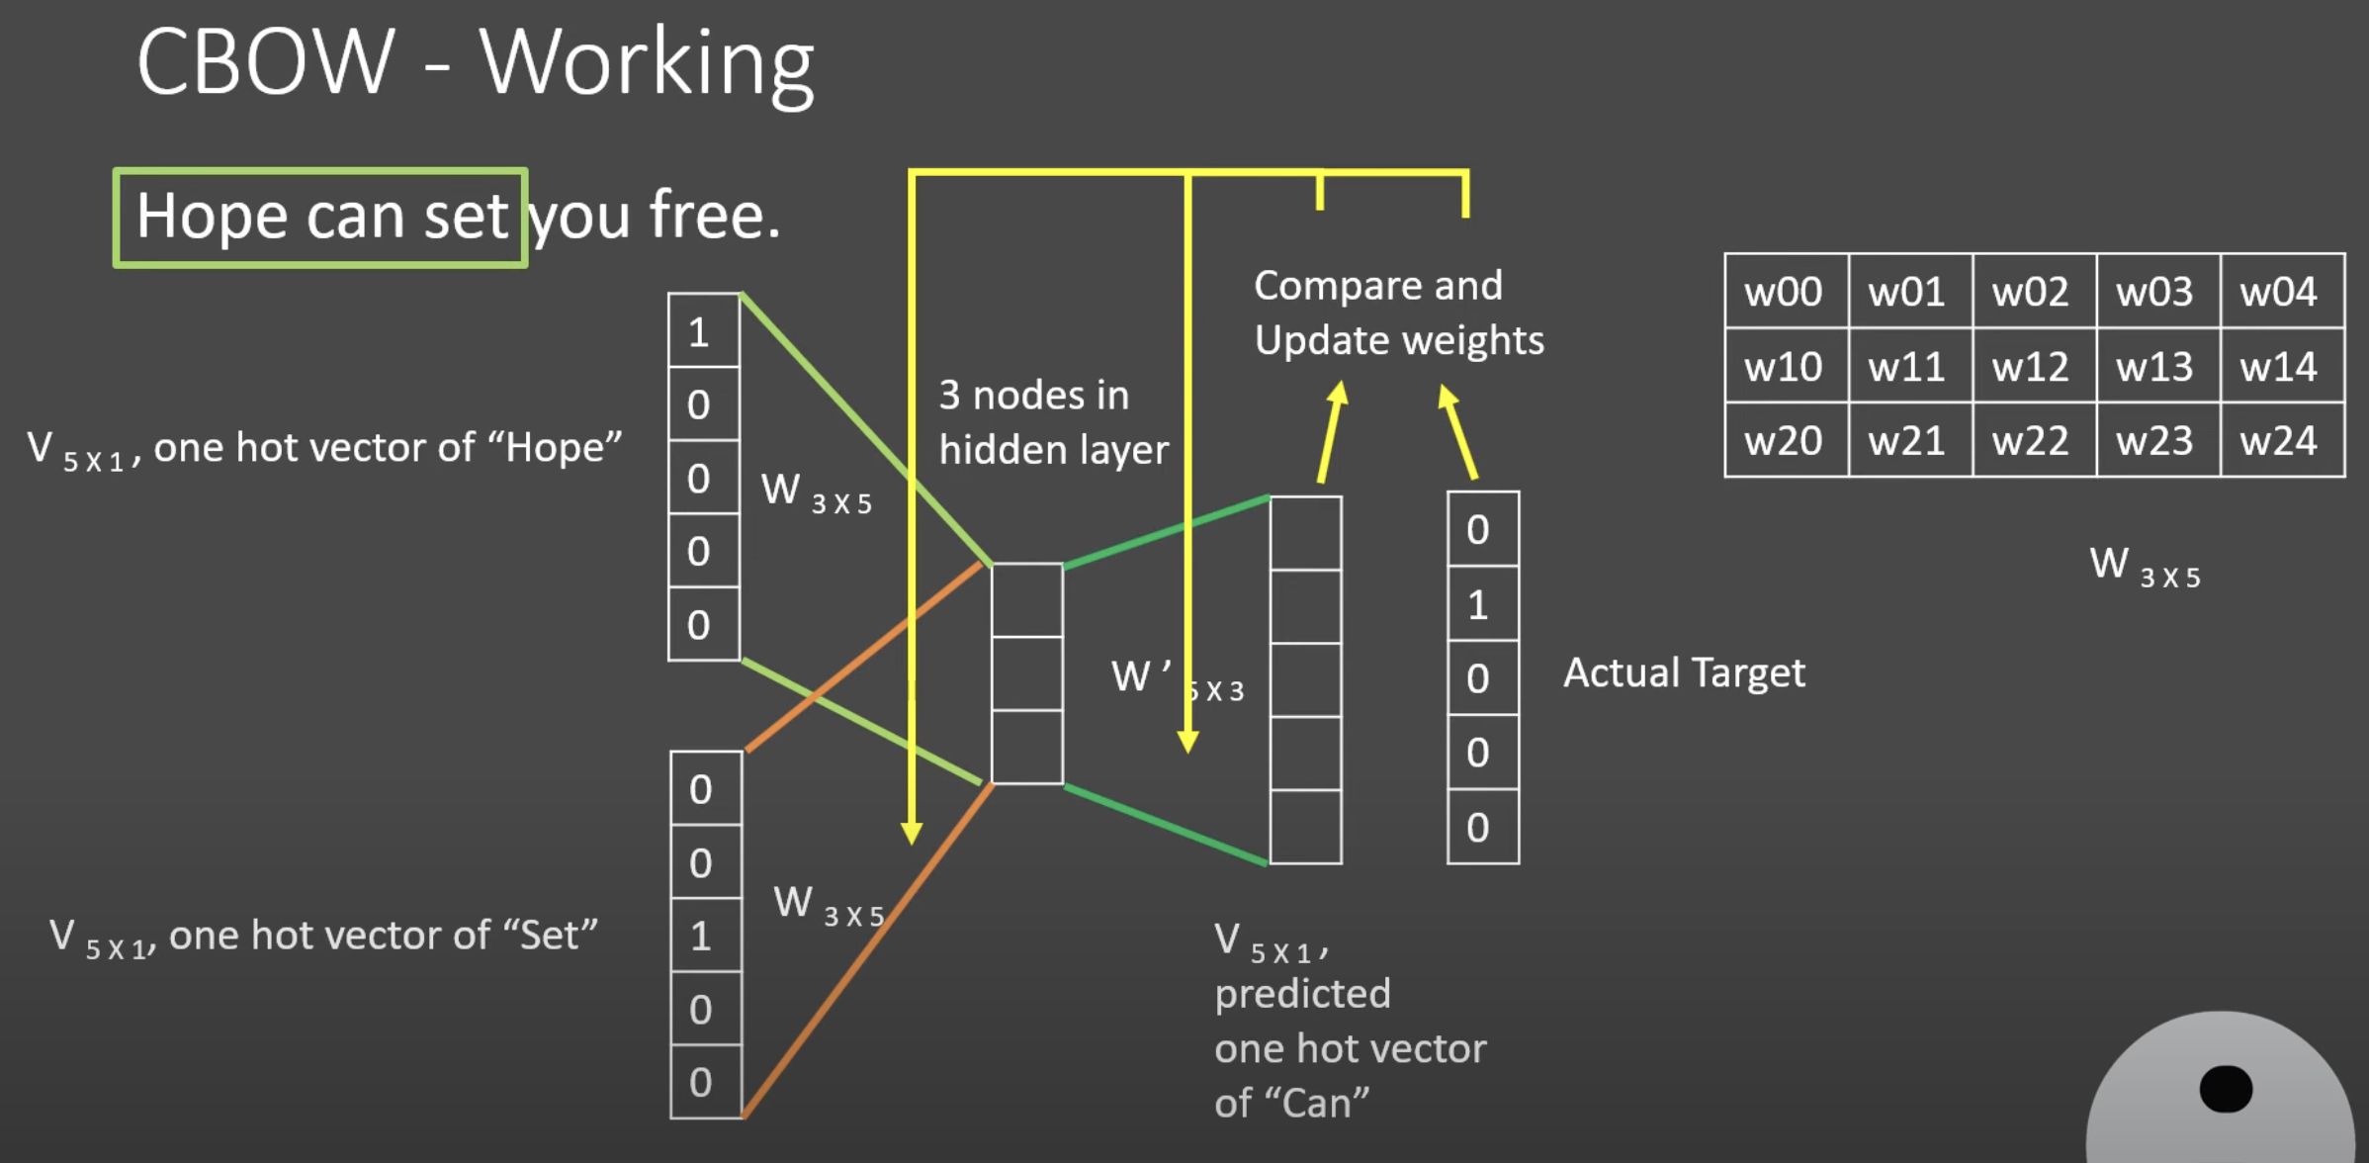
CBOW training architecture
Continuous Bag of Words approach (vs. skip-gram):
https://www.youtube.com/watch?v=UqRCEmrv1gQ

Slide 19
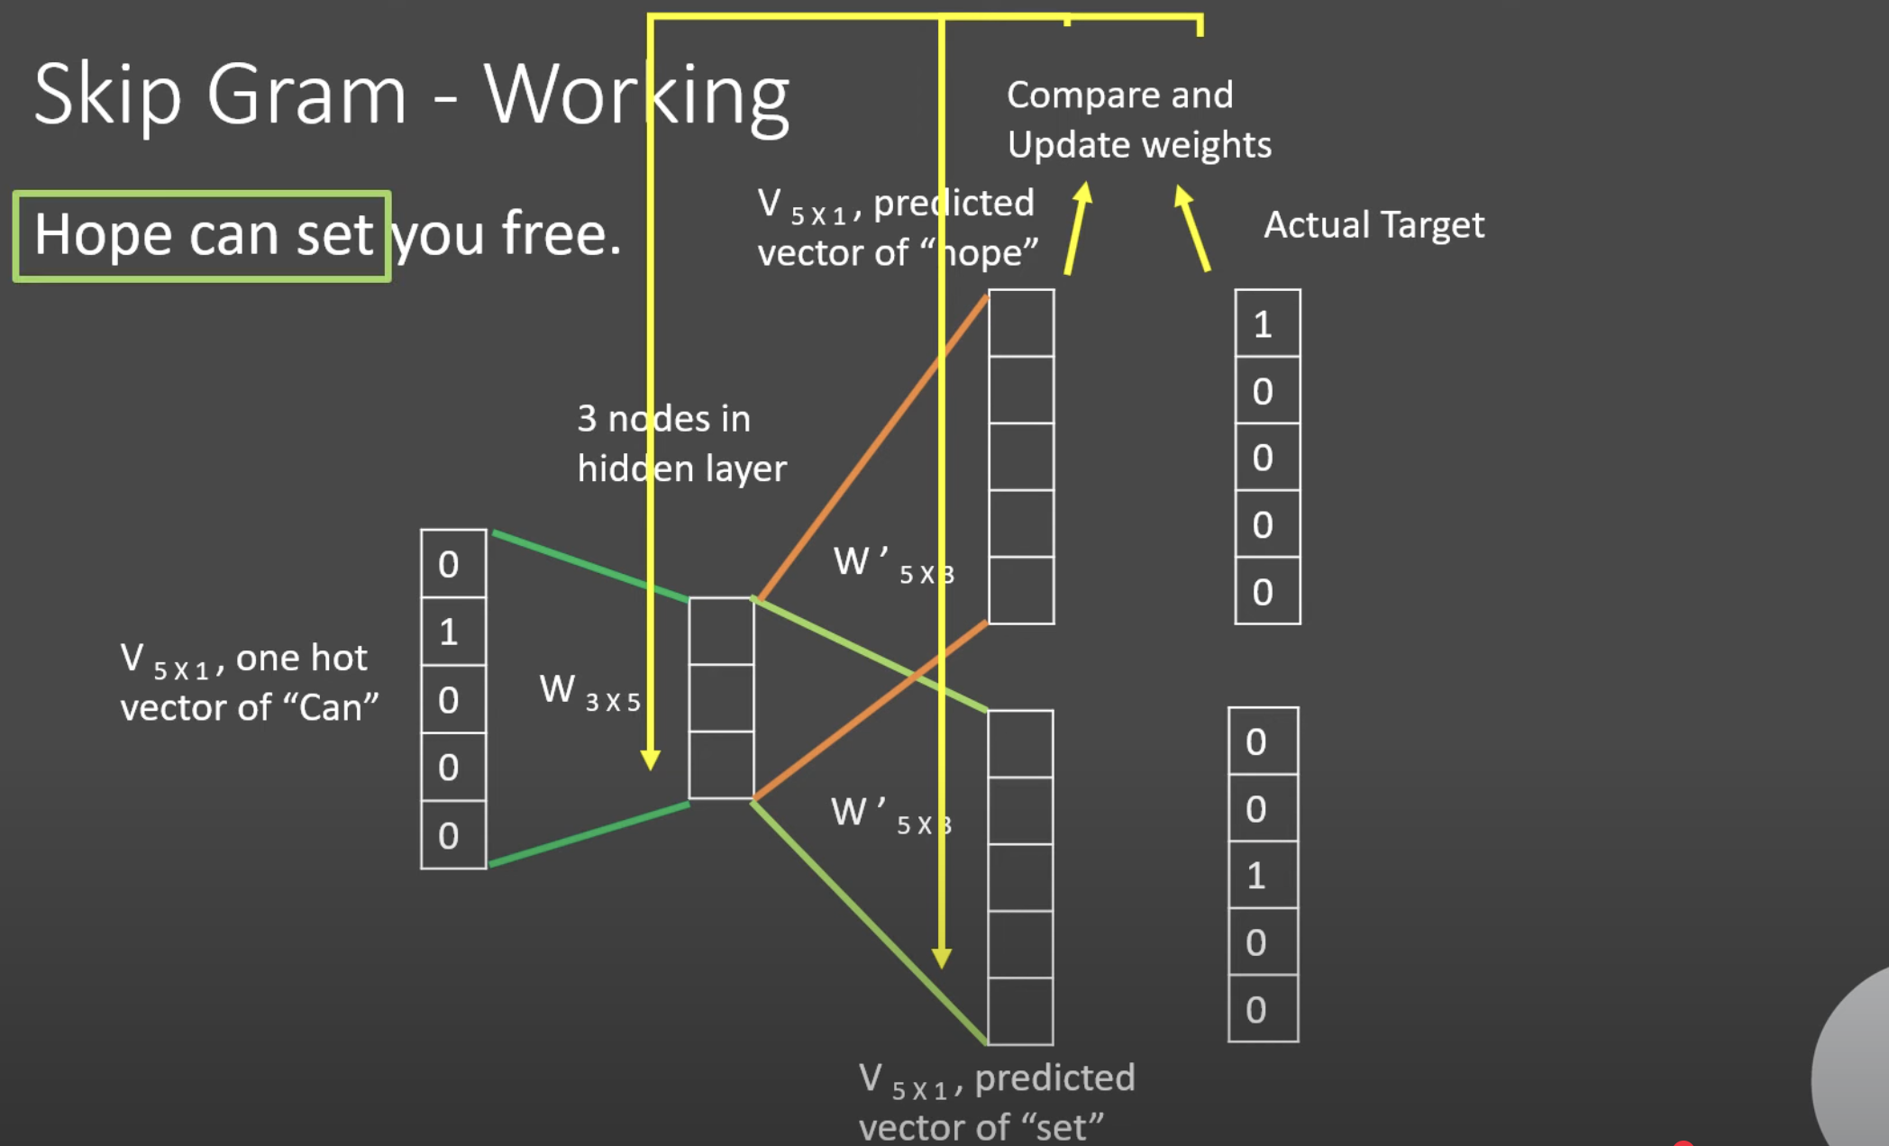
Skip-gram training architecture
https://www.youtube.com/watch?v=UqRCEmrv1gQ

Slide 20
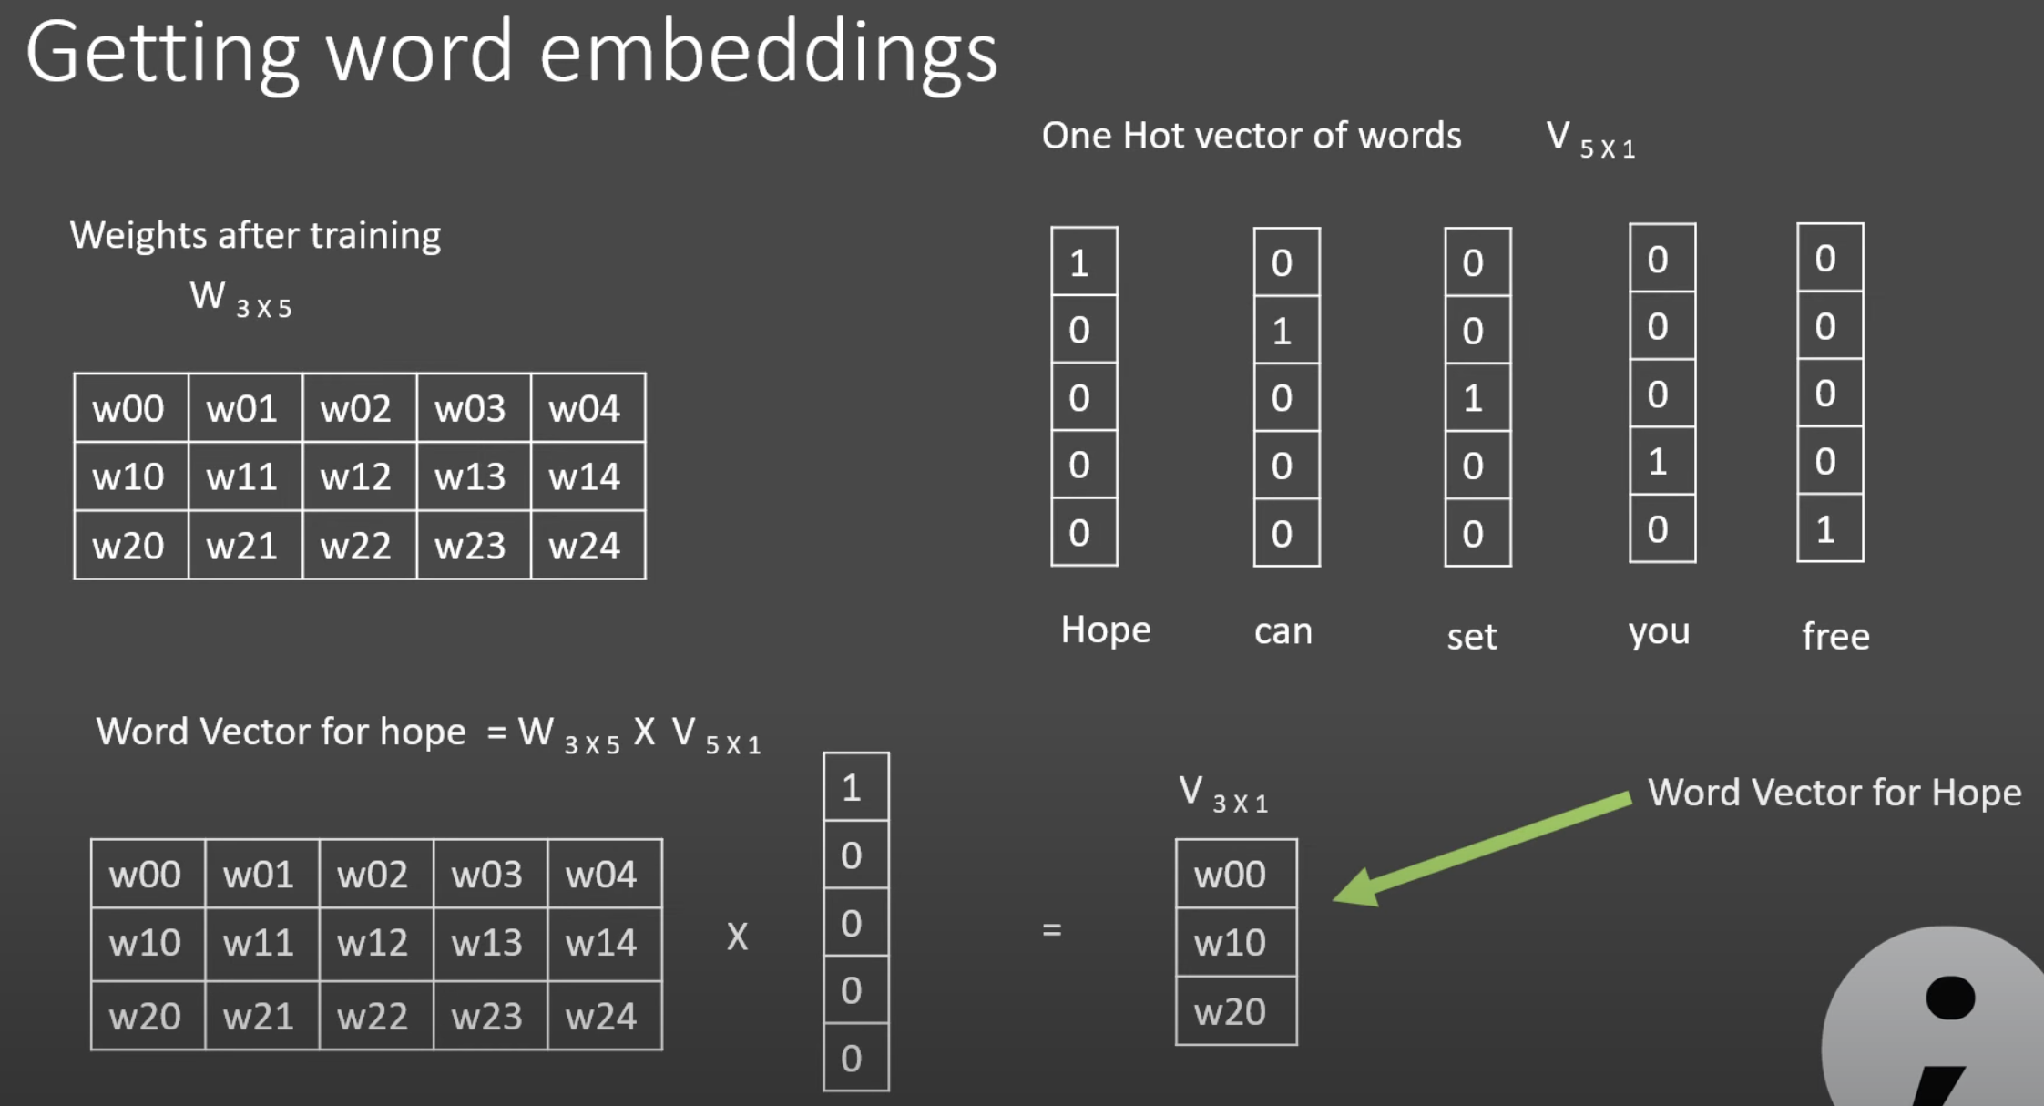
Use W matrix as word embedding
https://www.youtube.com/watch?v=UqRCEmrv1gQ

Slide 21
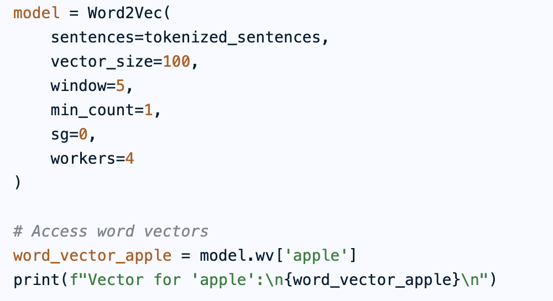
Practical considerations
Select the model training architecture
  Use CBOW for small corpus
  Use Skip-gram for large corpus, more dimensions
Increase the training size, vector dimensions

Slide 22
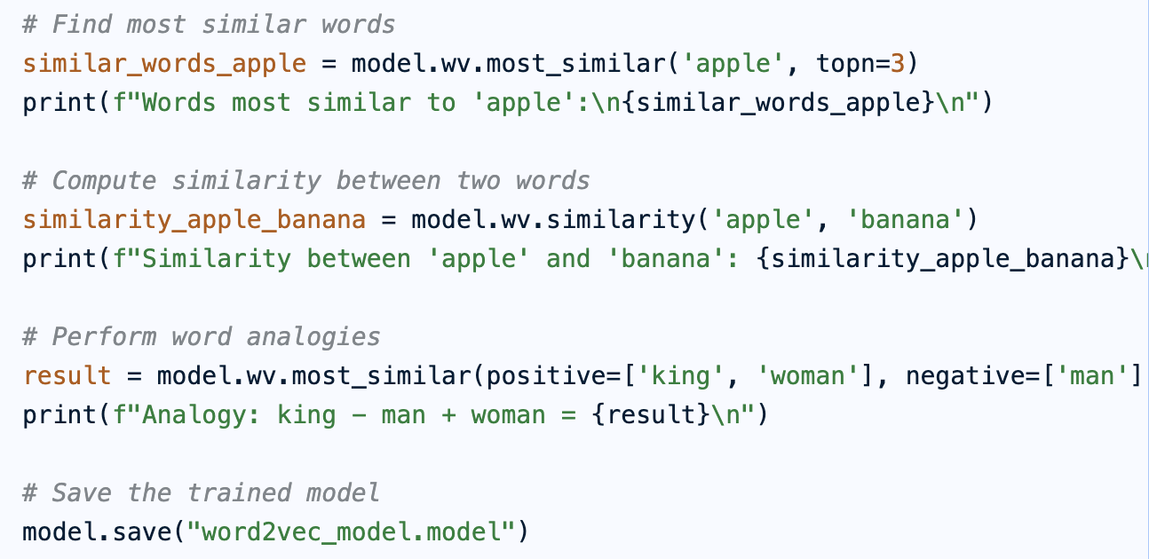
Python implementation

Slide 23
Pre-trained word2vec models
Training w2v from scratch is computational heavy.
Use pre-trained models on Facebook, Wikipedia, etc.
  https://wikipedia2vec.github.io/wikipedia2vec/pretrained/
  https://github.com/mmihaltz/word2vec-GoogleNews-vectors
Fine-tuning the model using your own domain data.
Only do it for a specific task that pretrained embeddings don't perform well on and you have lots of training data.
What if there are many words in our data which we could not find word vectors for in the pre-trained model?
  Our corpus of app reviews might have a very different vocabulary than a news corpus that was used for the pre-trained w2v model.
  Use the most similar word as substitute or simply ignore them.
Notes:
# Load 1,000,000 most common words
word2vec_model = gensim.models.KeyedVectors.load_word2vec_format(word2vec_path, binary=True, limit=1_000_000)
# Add one for padding token
num_tokens = len(tokenizer.word_index) + 1
# Word vector dimension
embedding_dim = 300
# Initialize matrix of zeros
embedding_matrix = np.zeros((num_tokens, embedding_dim))
# Fill embedding matrix
for word, i in tokenizer.word_index.items():
if word2vec_model.has_index_for(word):
embedding_matrix[i] = word2vec_model[word].copy()

Slide 24
Word2vec applications
Semantic analysis
  finding similar words; identify topics/themes
Document classification/clustering
  represent a document as the sum or average of all words’ vectors
  represent a document as a matrix (often used in Neural Net models)
Social network analysis
  treat nodes/users as words and obtain “user” vectors using w2v
  obtain “sentences” of users using random walk on the network
Linguistic bias analysis
  by analyzing word associations via cosine similarity
  E.g., gender stereotypes in job descriptions

Slide 25
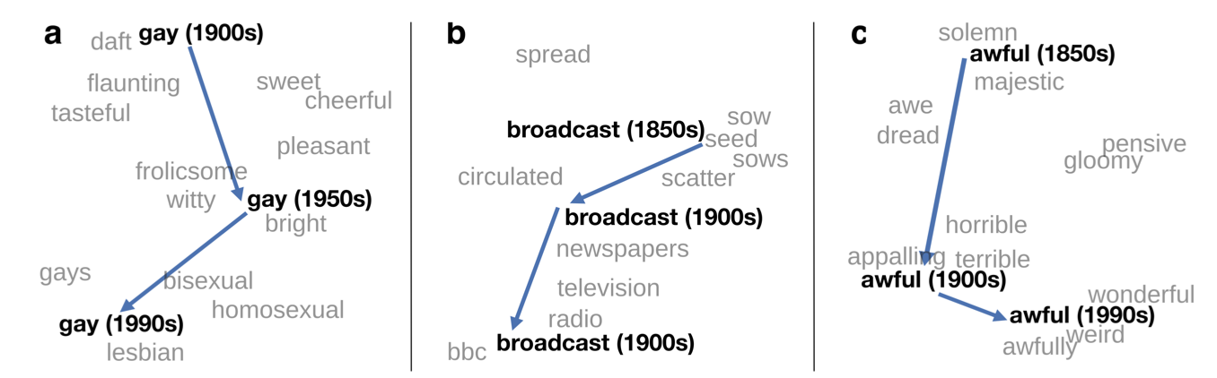
Detect semantic shift using w2v
Words change their meaning throughout history
  Vital for tracking cultural /societal change
  Key to developing robust language models
Are there statistical “laws” of semantic evolution?
Hamilton et al., “Diachronic Word Embeddings Reveal Statistical Laws of Semantic Change”. ACL 2016.

Slide 26
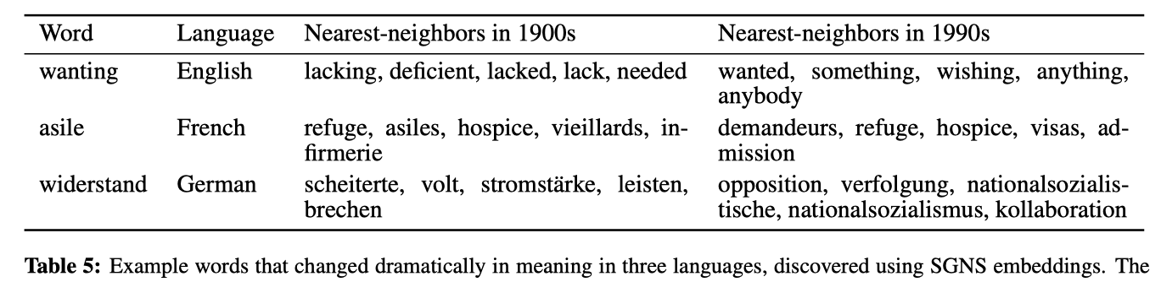
Detect semantic shift using w2v
Data: Google Books spanning 200 years in 4 languages
Diachronic embeddings: obtain w2v for each year period
Measures of semantic change (after alignment):
  Changes in pairwise word similarities over time
  Displacement of each word in vector space over time
Hamilton et al., “Diachronic Word Embeddings Reveal Statistical Laws of Semantic Change”. ACL 2016.

Slide 27
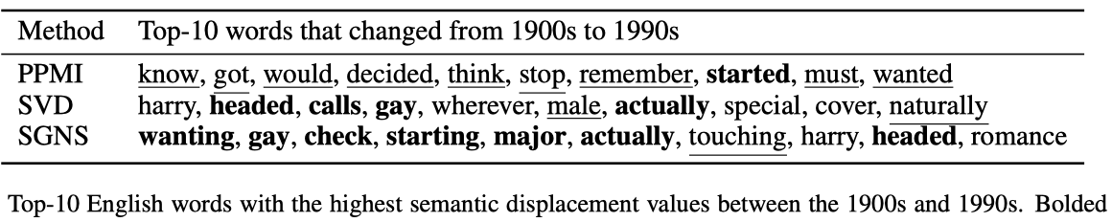
Detect semantic shift using w2v
Data: Google Books spanning 200 years in 4 languages
Diachronic embeddings: obtain w2v for each year period
Measures of semantic change (after alignment):
  Changes in pairwise word similarities over time
  Displacement of each word in vector space over time
Hamilton et al., “Diachronic Word Embeddings Reveal Statistical Laws of Semantic Change”. ACL 2016.

Slide 28
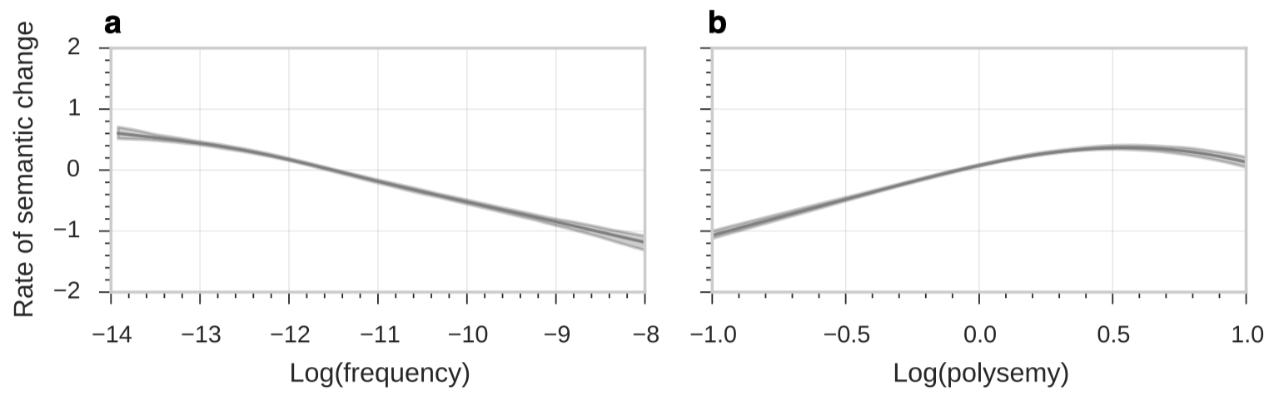
Detect semantic shift using w2v
Statistical laws of semantic shift:
  Law of conformity: Frequent words change at slower rates
  Law of innovation: Polysemous words change at faster rates
  Both relationships scale as power laws
Hamilton et al., “Diachronic Word Embeddings Reveal Statistical Laws of Semantic Change”. ACL 2016.

Slide 29
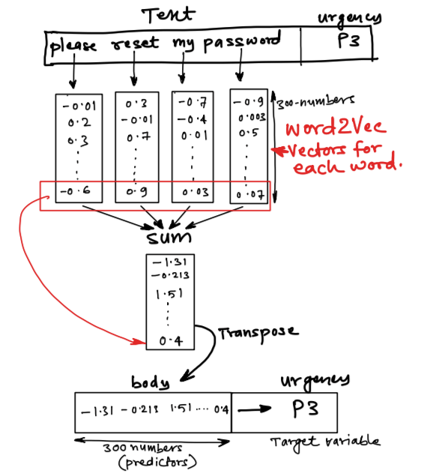
Sentiment prediction via w2v
Represent a text as its sum/avg word vector:
  Apply logit model

Slide 30
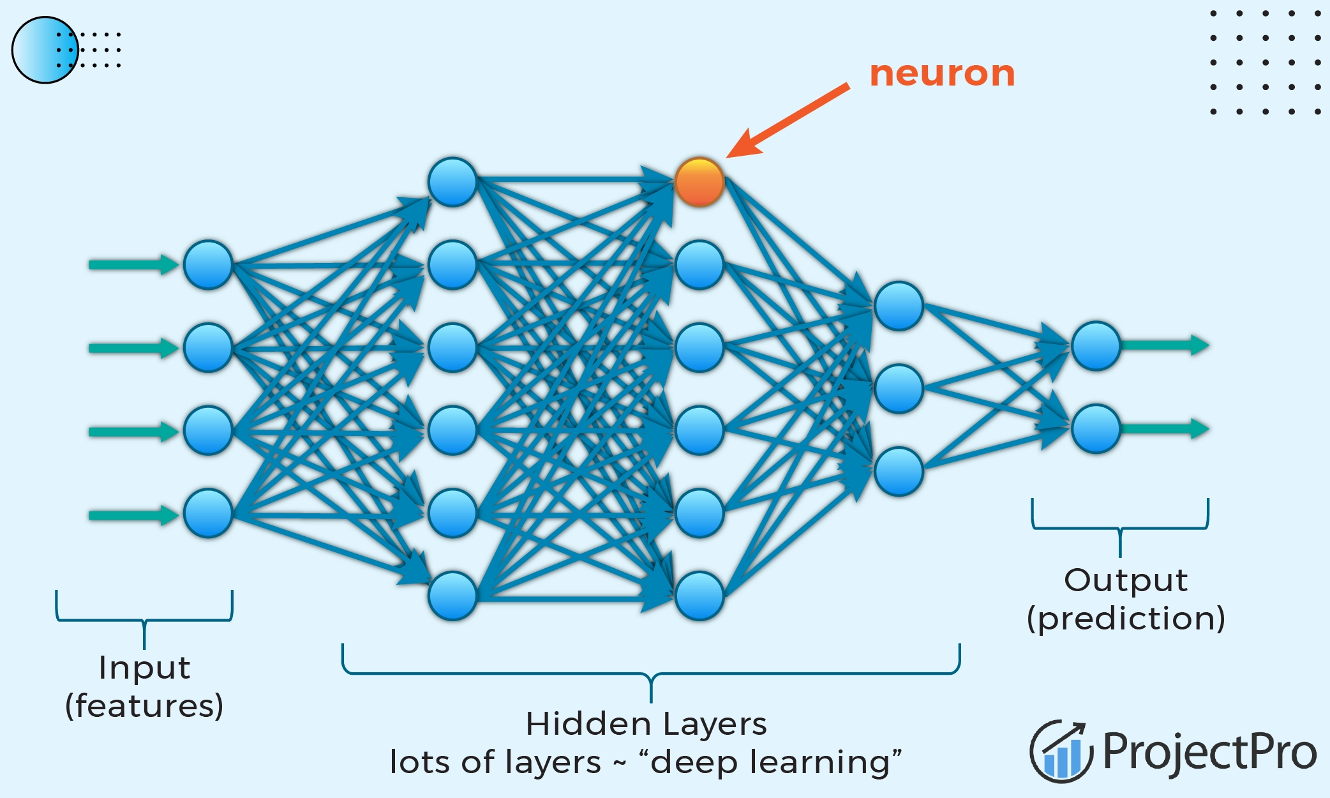
Sentiment prediction via w2v
Represent a text as its sum/avg word vector:
  Or use Neural Network model
https://www.projectpro.io/article/deep-learning-architectures/996

Slide 31
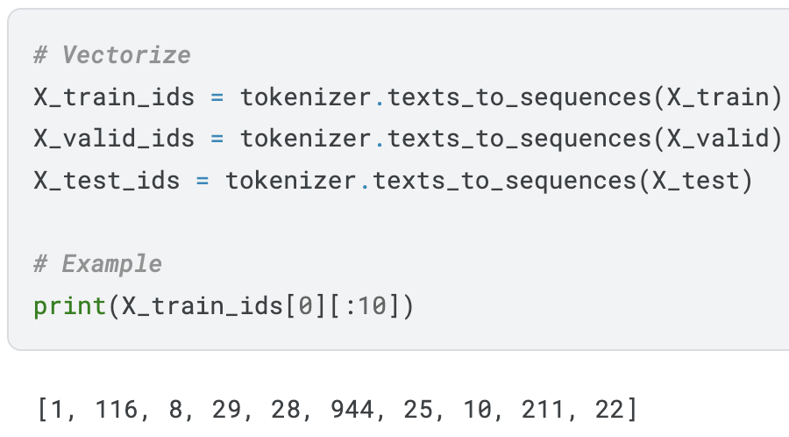
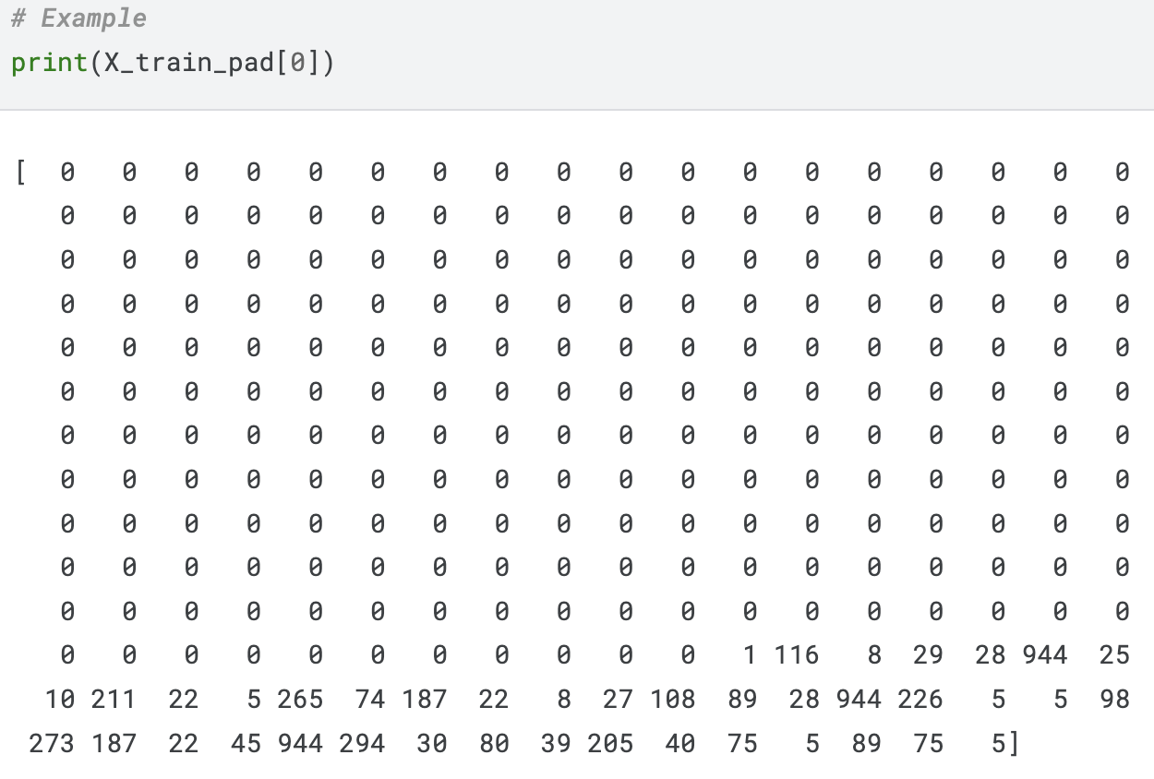
Sentiment prediction via w2v
Represent a text as a matrix (like an image):
  Use padding to convert all texts to the same length. Longer sequences are truncated and shorter sequences are padded with 0's at the beginning. E.g. set “max_length = 250”.
  If N = 300, this text will be transformed to a 250 x 300 matrix.
https://www.kaggle.com/code/samuelcortinhas/nlp7-word-embeddings
Notes:
By applying the big embedding matrix W (vol_size x 300) to a one-hot encoding matrix (250 x vol_size)

Slide 32
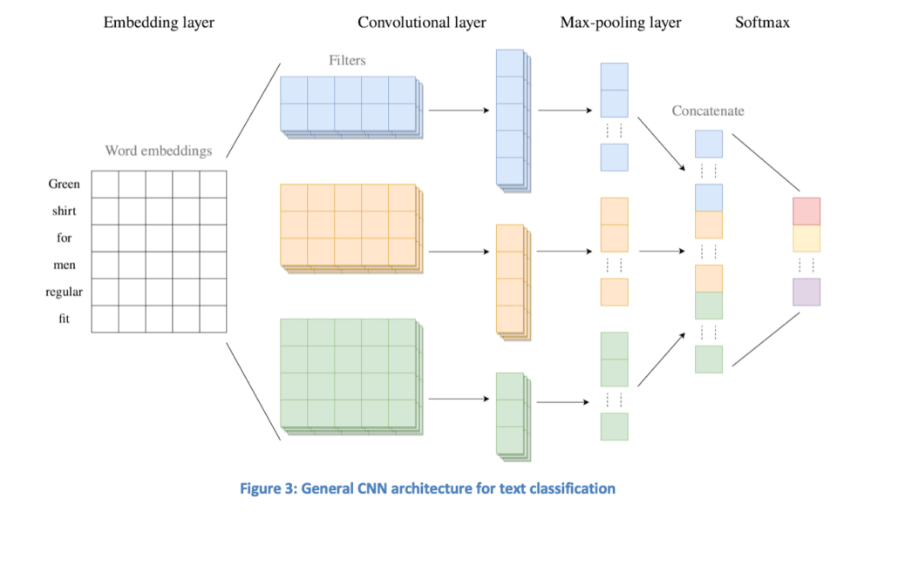
Sentiment prediction via w2v
Then the task is like using deep learning models (CNN) to do image classification on a 250 x 300 matrix.
  250 is the text length after padding
  300 is the embedding length

Slide 33
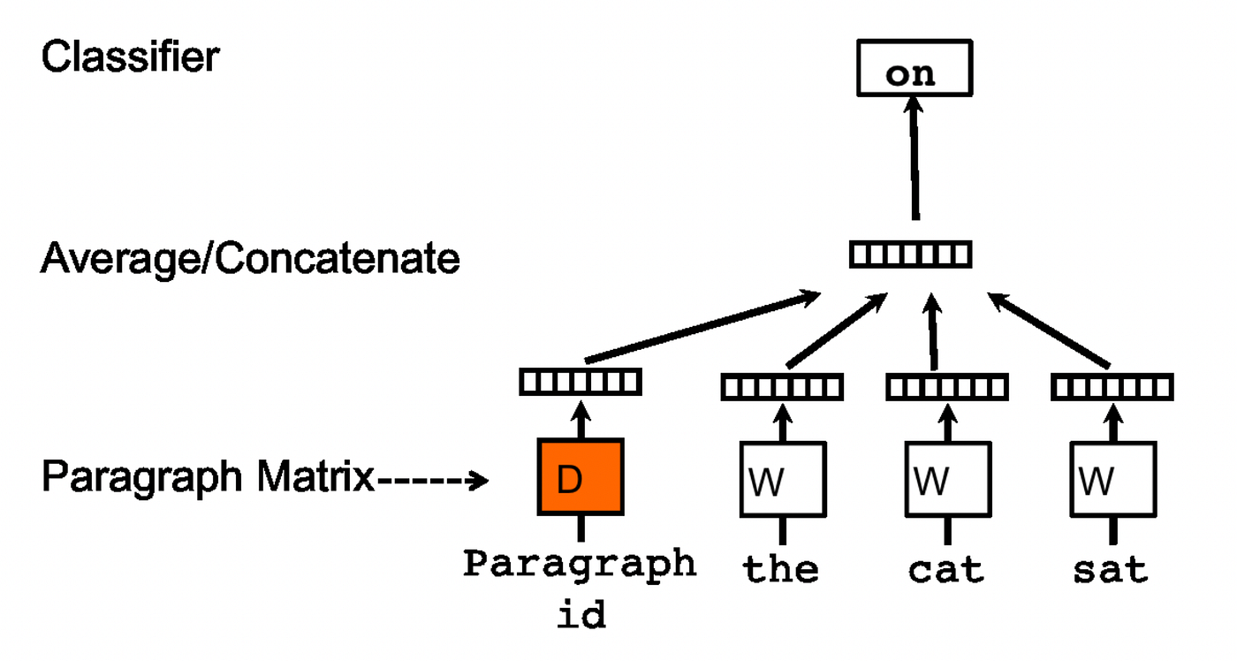
From w2v to doc2vec
Extension of w2v to directly learn document-level vector
Two architecture:
Distributed Memory (DM): Predict the next word given current words and the document vector, treated as a memory component that helps the model capture the overall theme or topic of the document.
Notes:
https://kharepratyush.medium.com/deep-learning-for-nlp-word2vec-doc2vec-and-top2vec-demystified-3842b4fad5c9

Slide 34
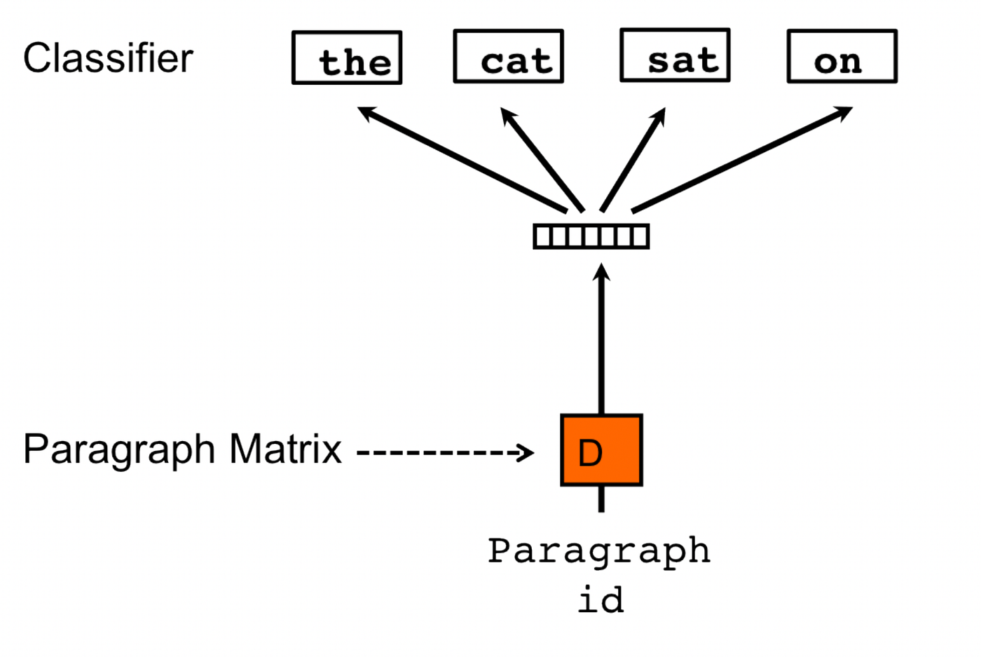
From w2v to doc2vec
Extension of w2v to directly learn document-level vector
Two architecture:
Distributed Bag of Words (DBOW): Predict a set of randomly sampled target words in the document given the document vector alone.
Notes:
https://kharepratyush.medium.com/deep-learning-for-nlp-word2vec-doc2vec-and-top2vec-demystified-3842b4fad5c9

Slide 35
w2v vs. doc2vec
The core benefit of doc2Vec over word2vec is that it learns vector representations for entire documents or sentences, which is suitable for tasks that require understanding the meaning of a whole text block.
When to use which:
Use w2v when your primary goal is to work with individual words: finding synonyms, analogies, or creating features for word-level tasks.
Choose Doc2Vec when your task requires a representation of a larger text unit: document classification, sentiment analysis on reviews, recommendation systems, or finding similar documents in a corpus.

Slide 36
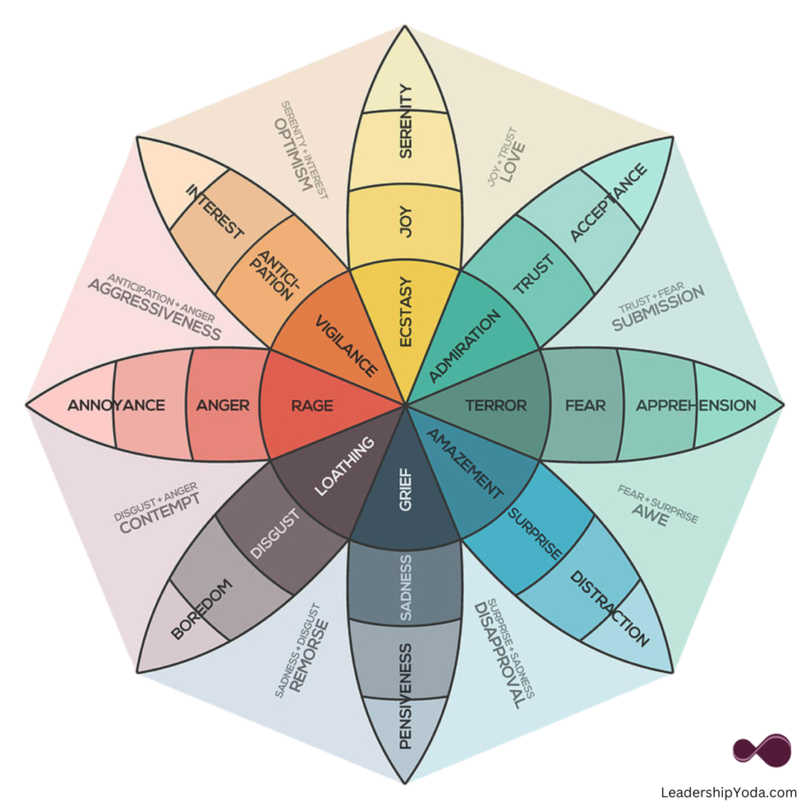
Plutchik’s Wheel of Emotions
Notes:
Primary emotions are kept in the second concentric circle. Most intense emotions are at the core centre of the wheel, and the intensity of emotions diminishes as you move outwards.

Slide 37
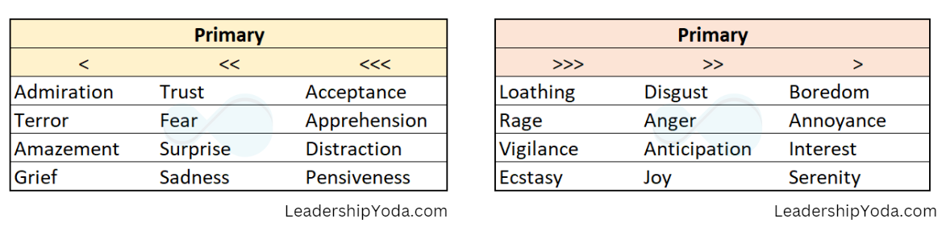
Plutchik’s Wheel of Emotions
8 primary emotions arranged in opposing pairs (2nd circle)
  joy, trust, fear, surprise, sadness, disgust, anger, and anticipation
Each emotion has a spectrum of intensity
  annoyance is a less intense form of anger (outer circle)
  while rage is a more intense form of anger (inner circle)
Combinations of primary emotions produce new emotions
  joy + trust -> love; joy + fear -> guilt
https://leadershipyoda.com/understanding-emotions-using-the-wheel-of-emotions/

Slide 38
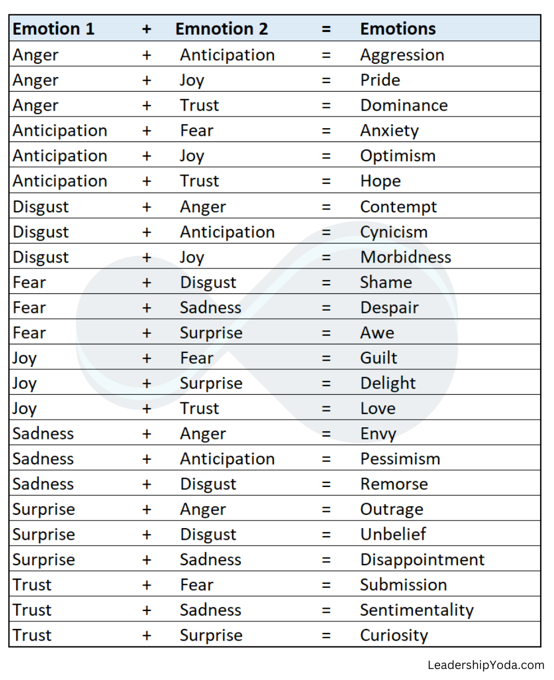
Plutchik’s Wheel of Emotions
Can model different categories:
  8 primary emotions (4 +/- pairs)
  8 intensified primary emotions
  8 weakened primary emotions
  24 mixed emotions --->
No mixture of opposite ones
  joy + sadness = ?
  anger + fear = ?

Slide 39
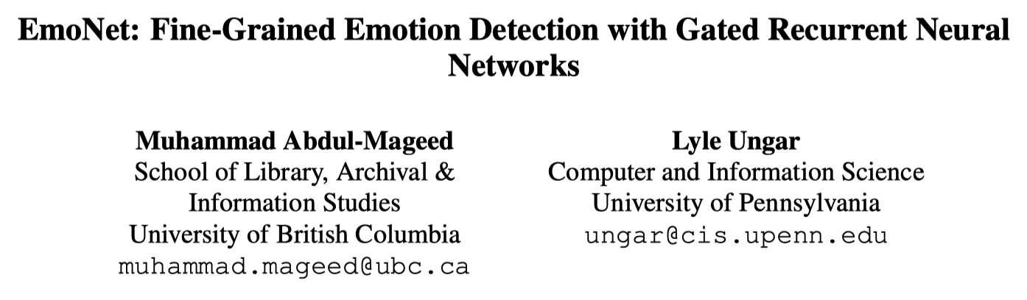
Predict emotion with Neural Nets
Identifying emotions using large-scale social media data:
Created 665 emotion words by expanding the 24 emotion types with synonyms
  Joy: {“happy”, “happiness”, “joy”, “joyful”, “joyfully”, “delighted”, “feel-ingsunny”, “blithe”, “beatiﬁc”, “exhilarated”, “blissful”, “walkingonair”, “jubilant”}
Use each word as a hashtag seed to extract tweets using API
Collected a dataset of 0.25 billion tweets in [2009, 2017].

Slide 40
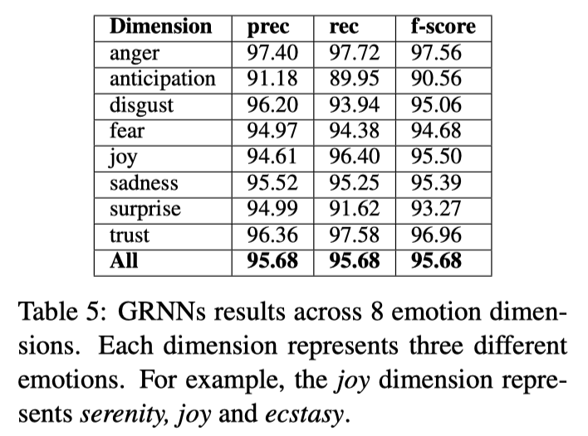
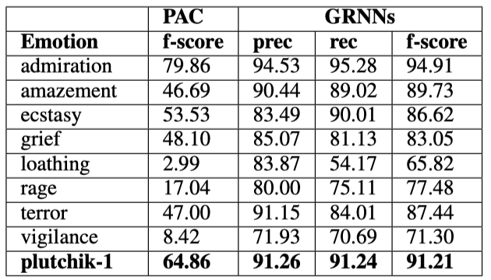
Predict emotion with Neural Nets
Gated recurrent neural net. VS. PAC:
predicting the 8 inner circle emotions
average f-score is over 0.9
Mageed & Ungar. EmoNet: Fine-grained emotion detection with gated recurrent neural networks. ACL 2017.

Slide 41
Other text classification tasks
Spam/clickbait detection
Helpfulness rating on Q&A sites
Complain/fake/rating of reviews
Civility/toxicity/hateful speech
Language identification of posts
Fake news / bot detection
Identify AIGC posts on RedNote

Slide 42

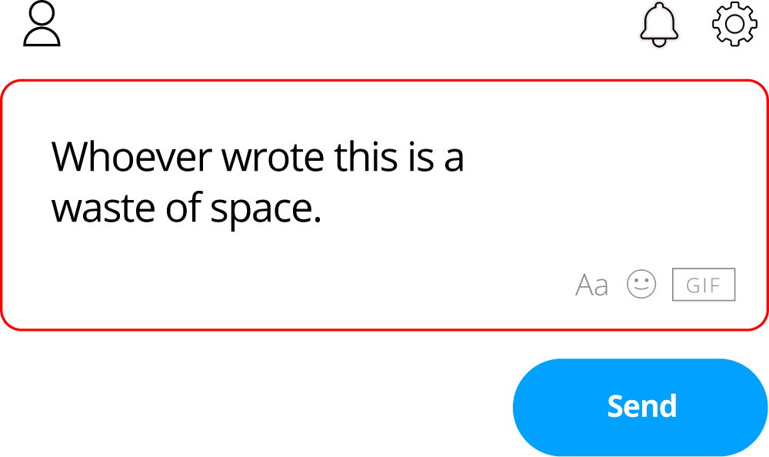
Toxicity detection
Good for content moderation for online platforms
Help to maintain healthy / civic conversations
Prevent online abuse and harassment

Slide 43
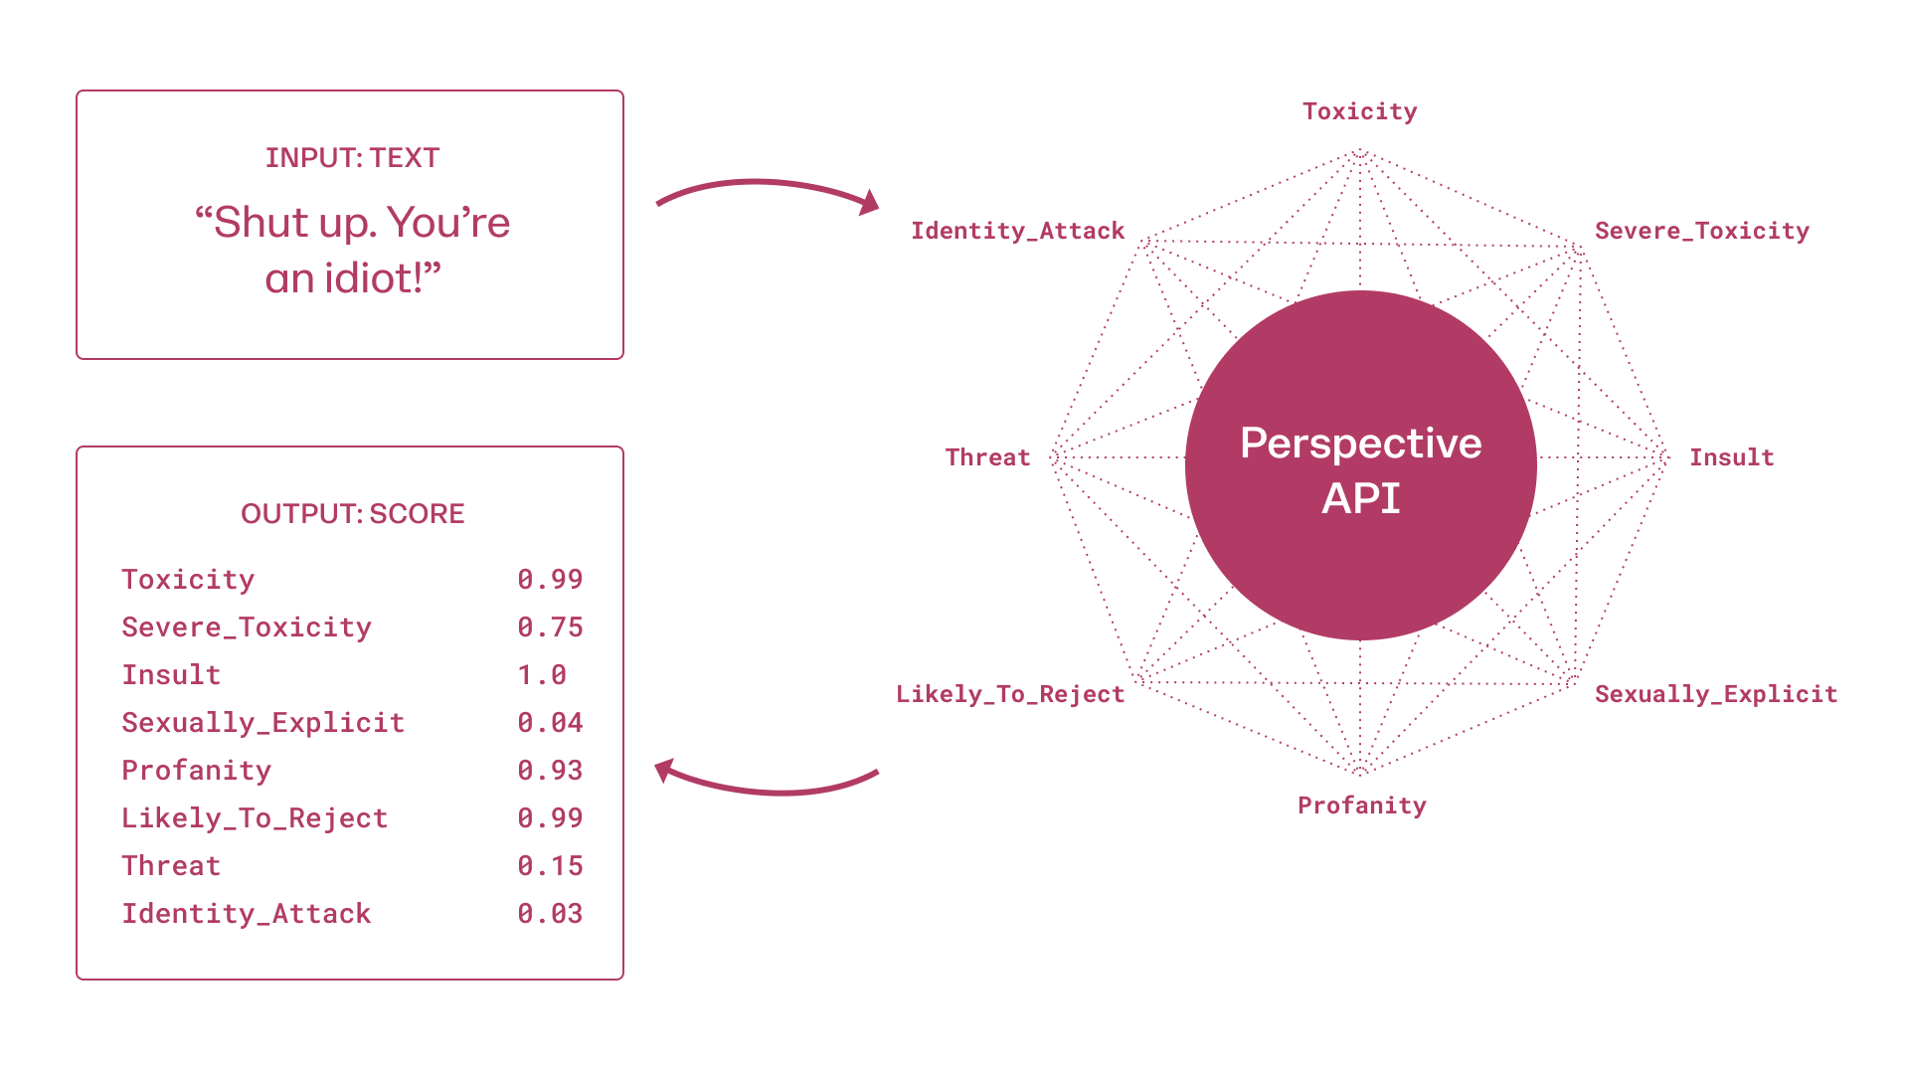
Perspective API by Google
Python library:
  https://developers.perspectiveapi.com/s/docs-sample-requests
Other Github package:
  https://github.com/baishalidutta/Comments-Toxicity-Detection

Slide 44
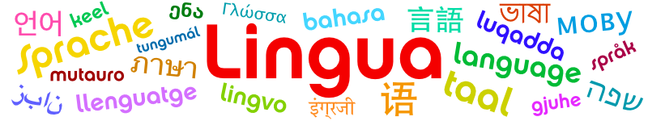
Language prediction
Needed for dataset filtering, marketing analysis
How to build a Naïve Beyes classifier on this data?
Doc | Text | Class
1 | this is my private domicile | English
2 | Don Eladio is dead | English
3 | Don Eladio está muerto | Spanish
4 | sus capos están muerto | Spanish
5 | my capos is muerto | ?

Slide 45
Language prediction
Python library:
  https://github.com/pemistahl/lingua-py

Slide 46
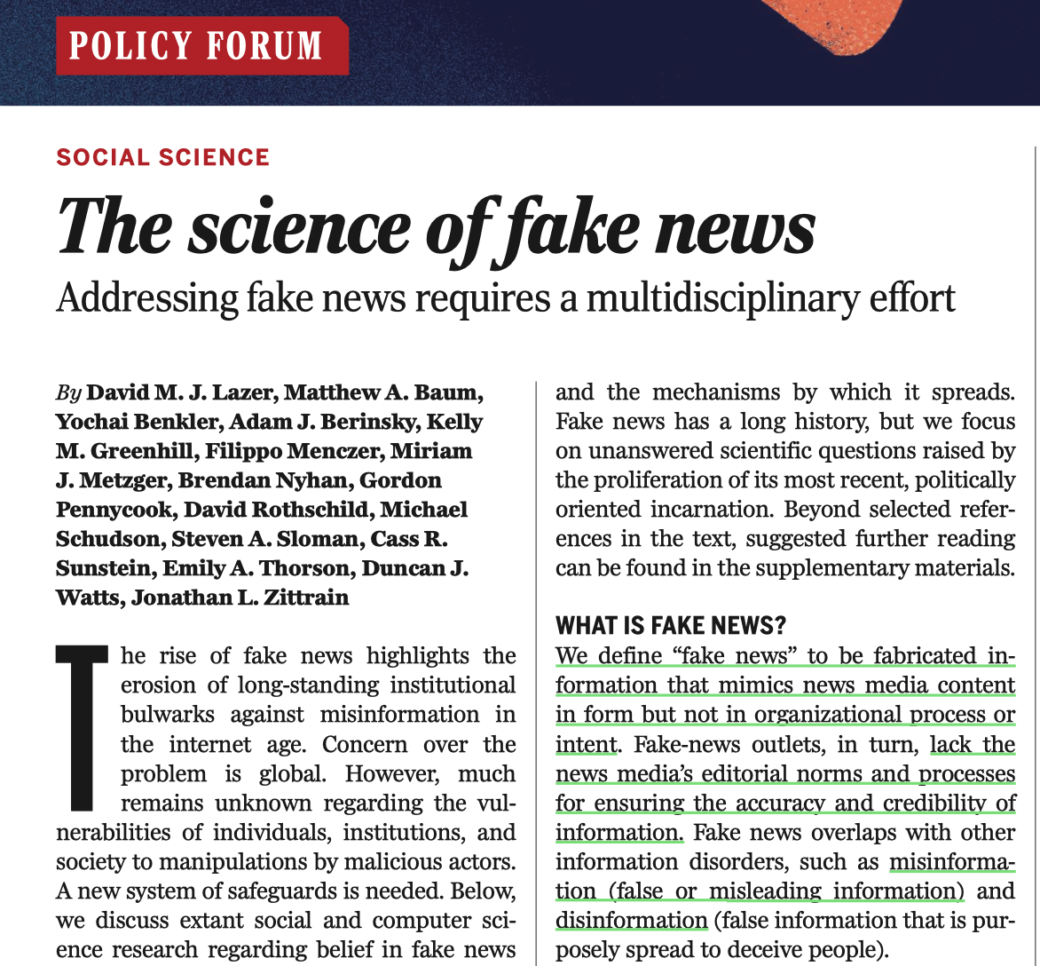
Lazer et al. 2018, Science

Slide 47
Fake news
Definition:
  Purposefully crafted, sensational, emotionally charged, misleading or totally fabricated information that mimics the form of mainstream news (Zimdars & McLeod, 2020).
Three varieties:
  Disinformation: Content that is intentionally false and designed to deceive people and cause harm.
  Misinformation: Misleading content but the person sharing doesn’t realize that it is false or misleading.
  Malinformation: Genuine information that is shared out of context with an intent to cause harm.

Slide 48
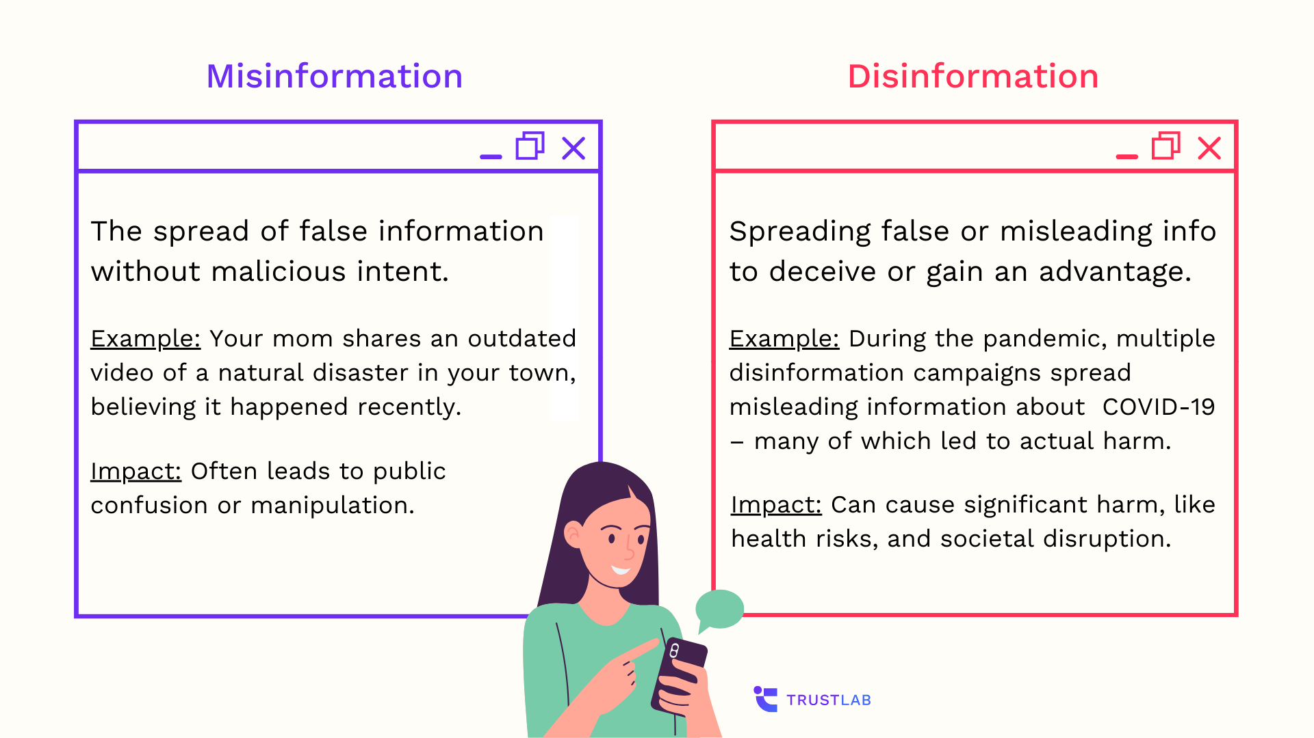
Fake news
Notes:
Question mark graphic, Week 2 preview.

Slide 49
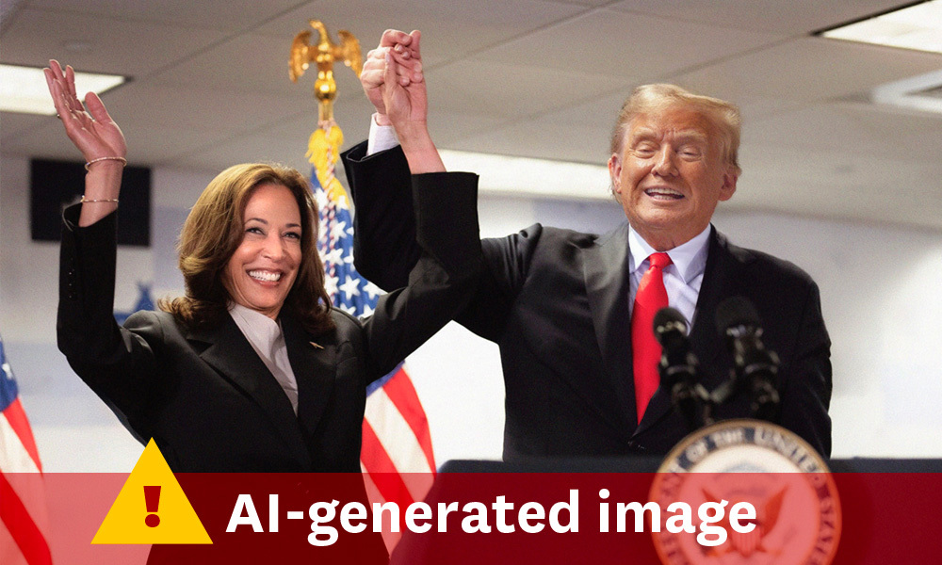
Fake news example
Notes:
Question mark graphic, Week 2 preview.

Slide 50
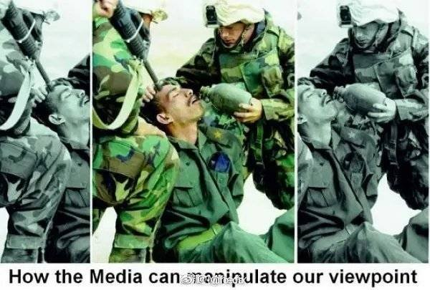
Fake news example
Soldiers saving lives or killing people?
Notes:
Question mark graphic, Week 2 preview.

Slide 51
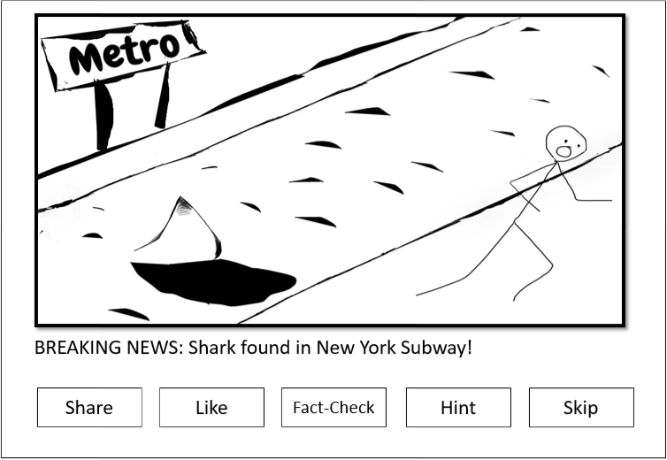
Fakey game
Play the game: https://fakey.osome.iu.edu/login

Slide 52
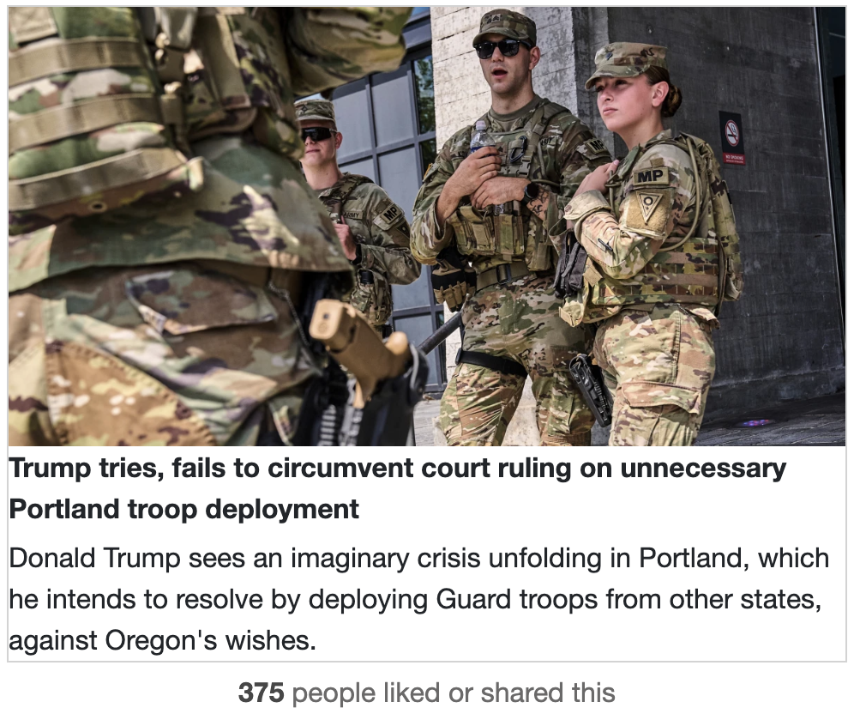
Hard for humans to identity
Notes:
This article comes from Msnbc, a mainstream source.

Slide 53
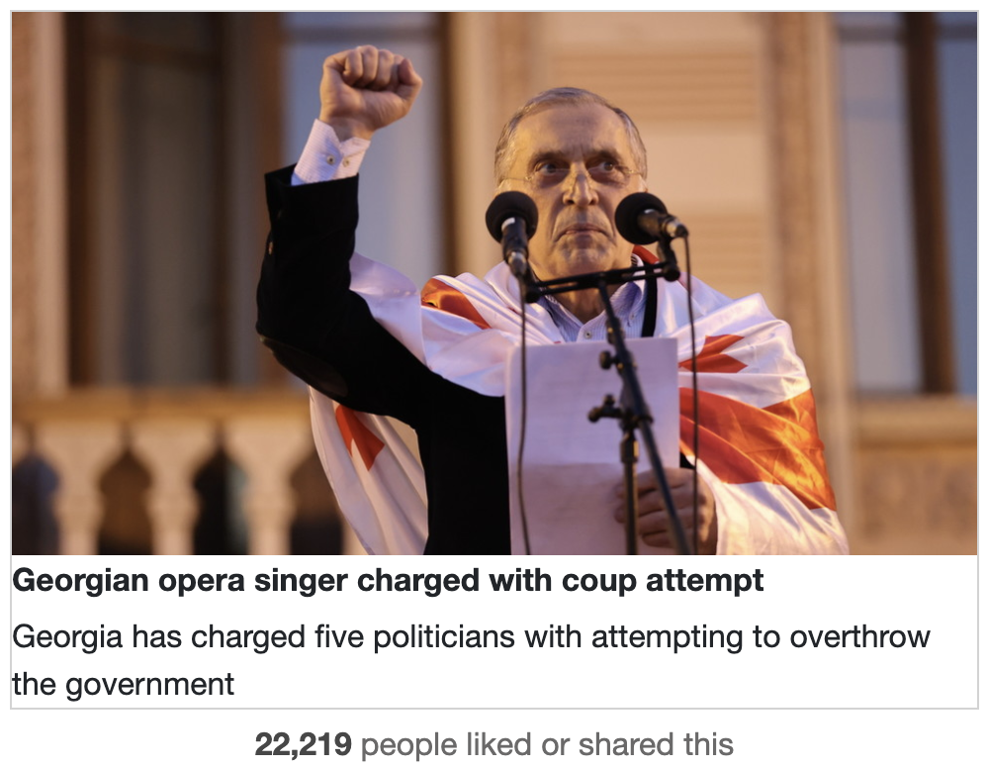
Hard for humans to identity
Notes:
This article comes from rt.com, a questionable source.

Slide 54
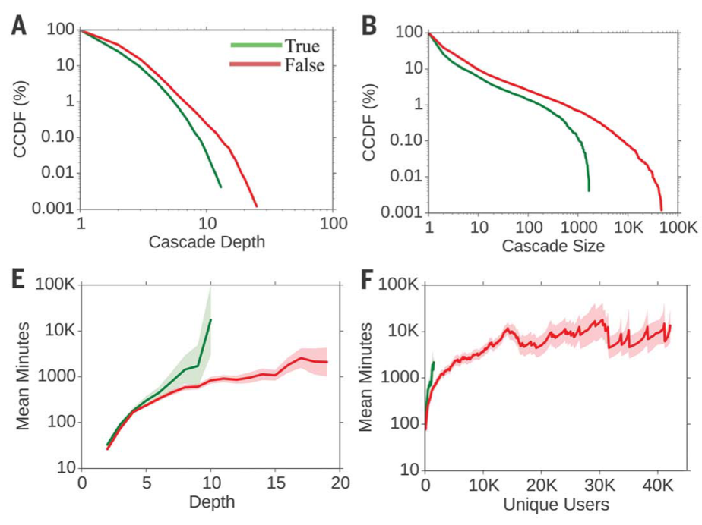
Lies spread faster than the truth
https://www.science.org/doi/10.1126/science.aap9559

Slide 55
Fake news impact
Undermines online trust, democracy, and public health (e.g., the COVID-19 misinformation).
Increase polarization and echo chamber effects.
Erosion of public trust in news media.

Slide 56
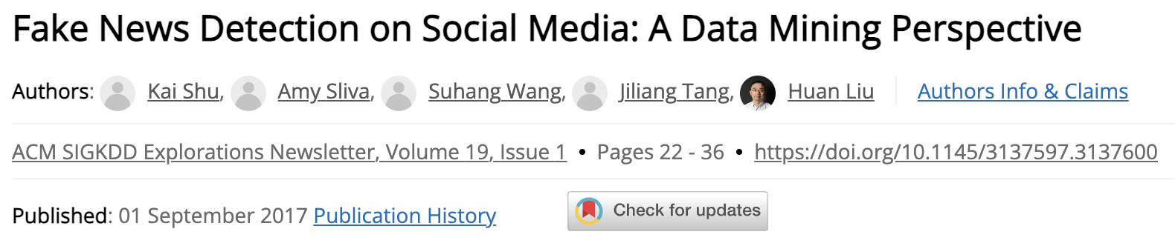
Fake news detection
A classification task (document-level or source-level)
High-quality data: https://www.snopes.com/fact-check/
Prediction using three sets of features:
  Source-level
  Content-level
  Spreading pattern (network-level)

Slide 57
Characteristics of fake news
Fake news uses distinct linguistic features for virality.
Examples: “NEVER Trust This Candidate!”.
Stylistic and Syntactic: Sensational headlines, high adjective ratios, and all-caps usage (e.g., clickbait patterns in BuzzFeed).
Psycholinguistic: Negative emotions (anger, fear) and persuasive language, often detected via LIWC tools (e.g., higher negation).
Readability: Simpler language, lower Flesch-Kincaid scores, and repetitive structures for broad appeal and sensational tone.
Lexical/Semantic: Low vocabulary richness and emotional words.

Slide 58
Course notes
Homework 1 will be released by end of this week.
  Due in two weeks (submit html file)
Upload paper presentation slides on Canvas
  Notify students your paper choice via Discussion 7 days before presentation time (points reduction if delayed).
  Turn on notifications for New Discussion on Canvas.
AI-assistance allowed, but human validation is required!
  I have numerous ways to test your understanding.
  E.g., ask clarification questions about paper content.
User Profiling next week
Behavioral Analysis the week after

